Slide 1

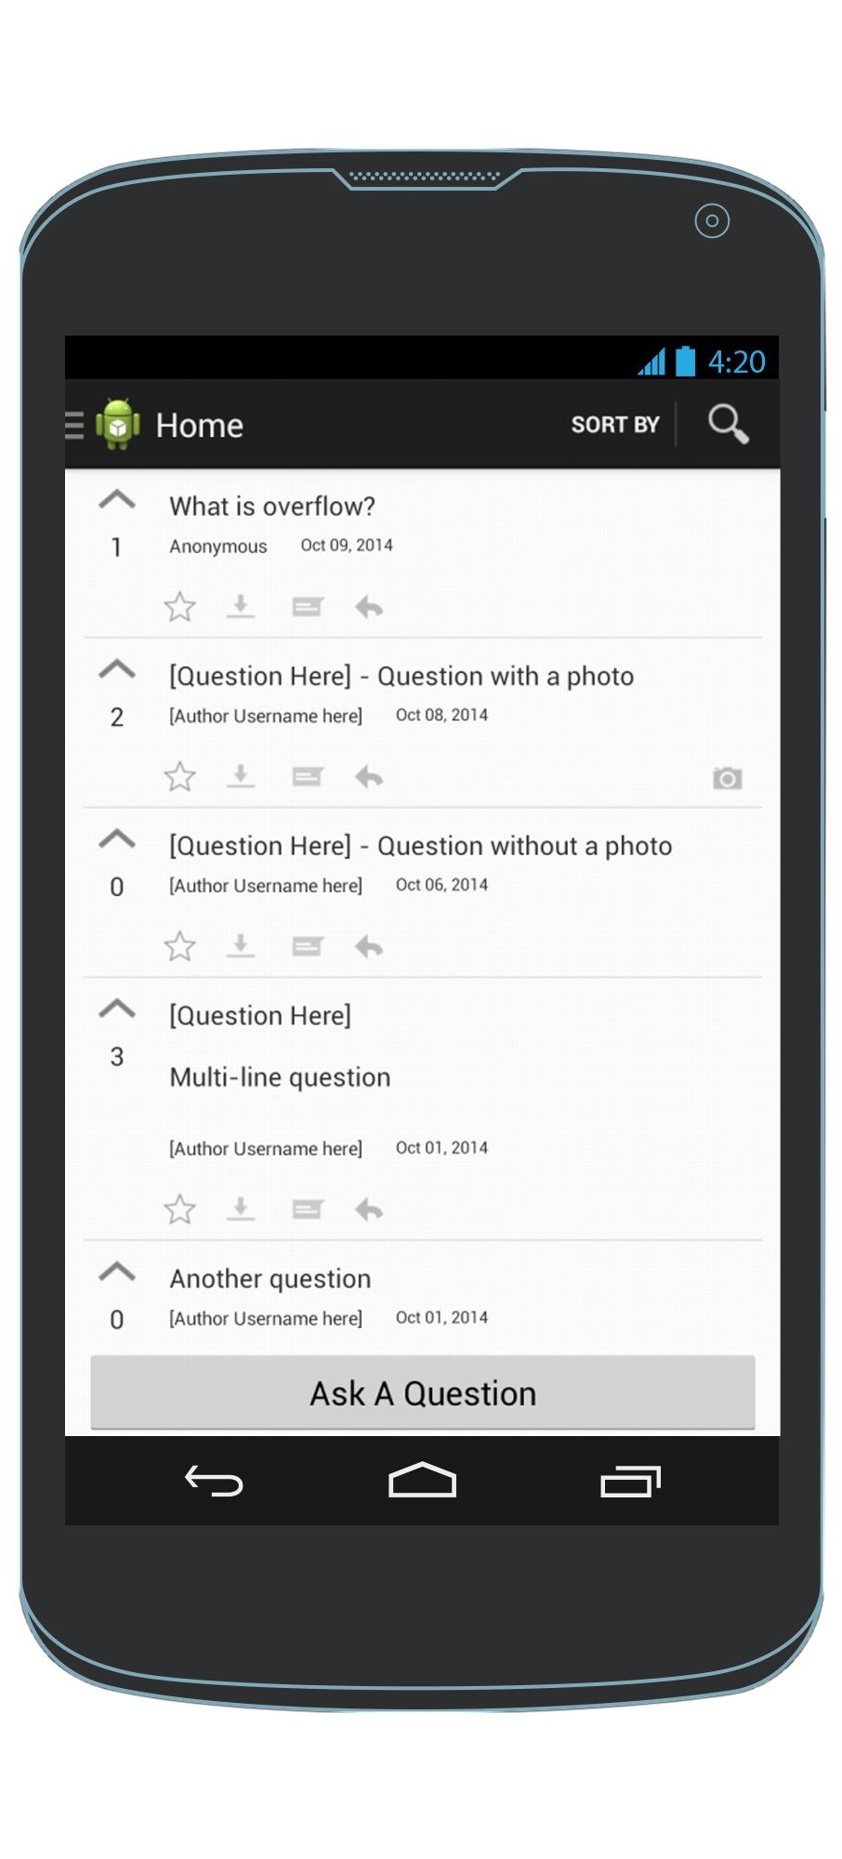





Upvote
Favorite
Scroll to browse questions
Mark as offline
Answer
Reply
HomeScreen
Picture Present Indicator

Slide 2
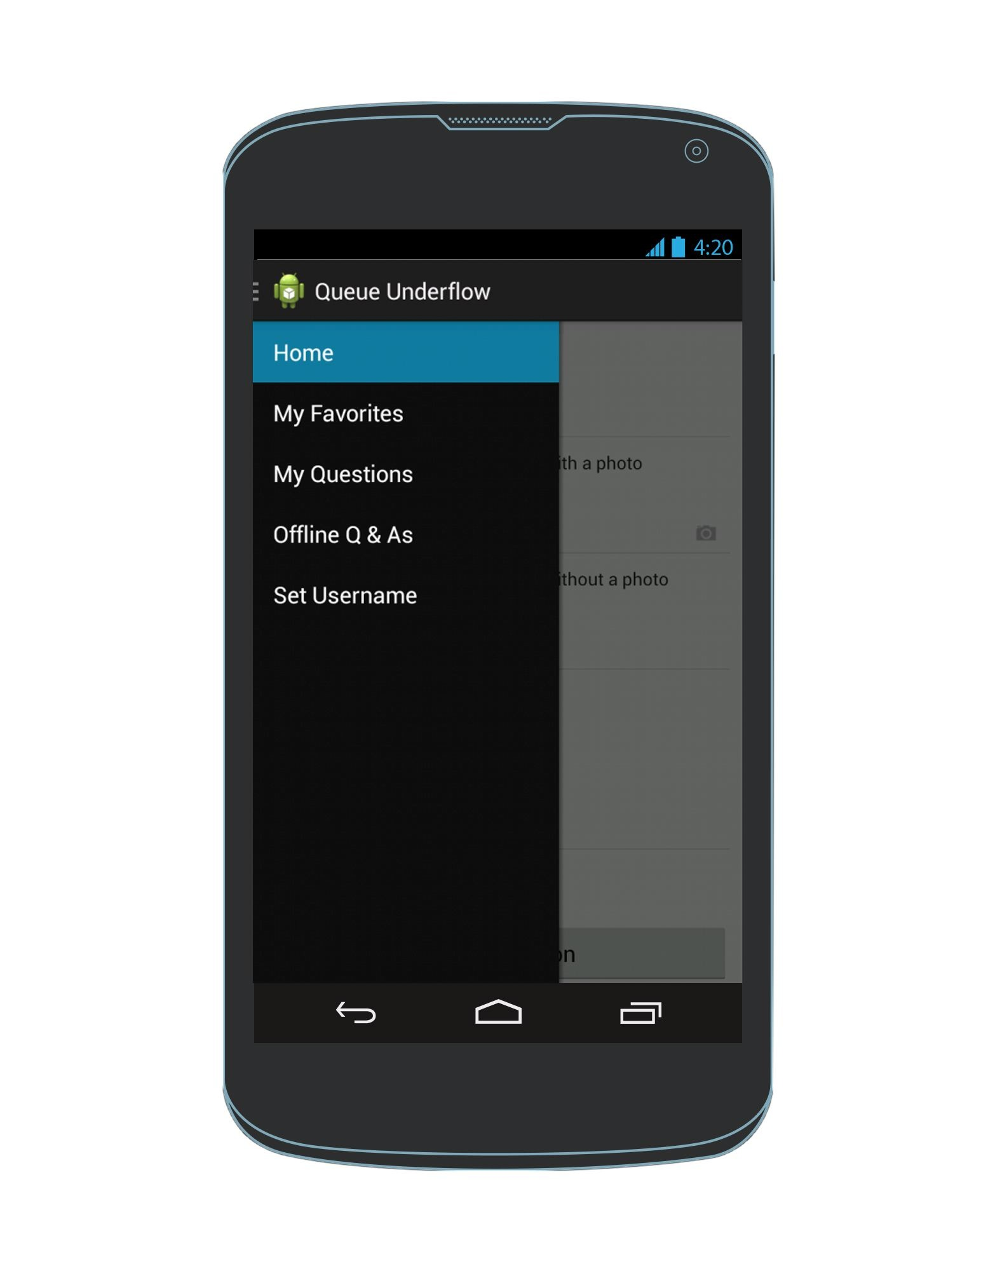
Accessing the navigation drawer
Click this
OR
Swipe from the left edge towards the right
Any Screen
Navigation Drawer

Slide 3
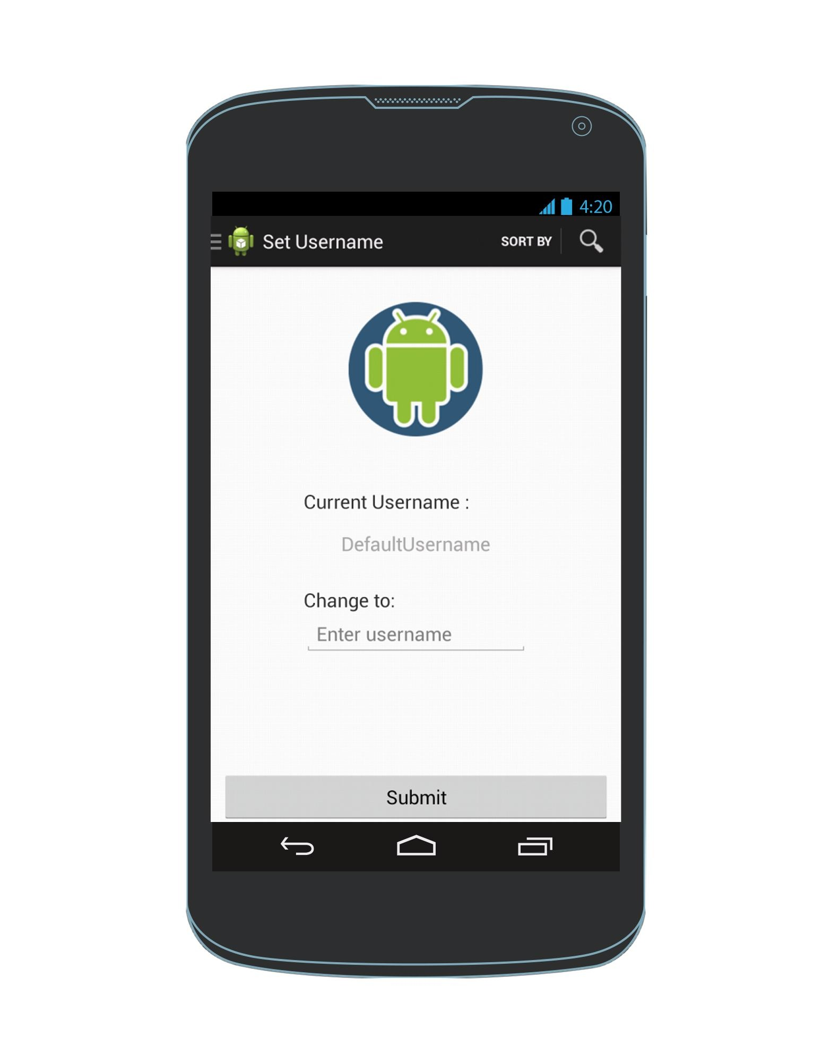
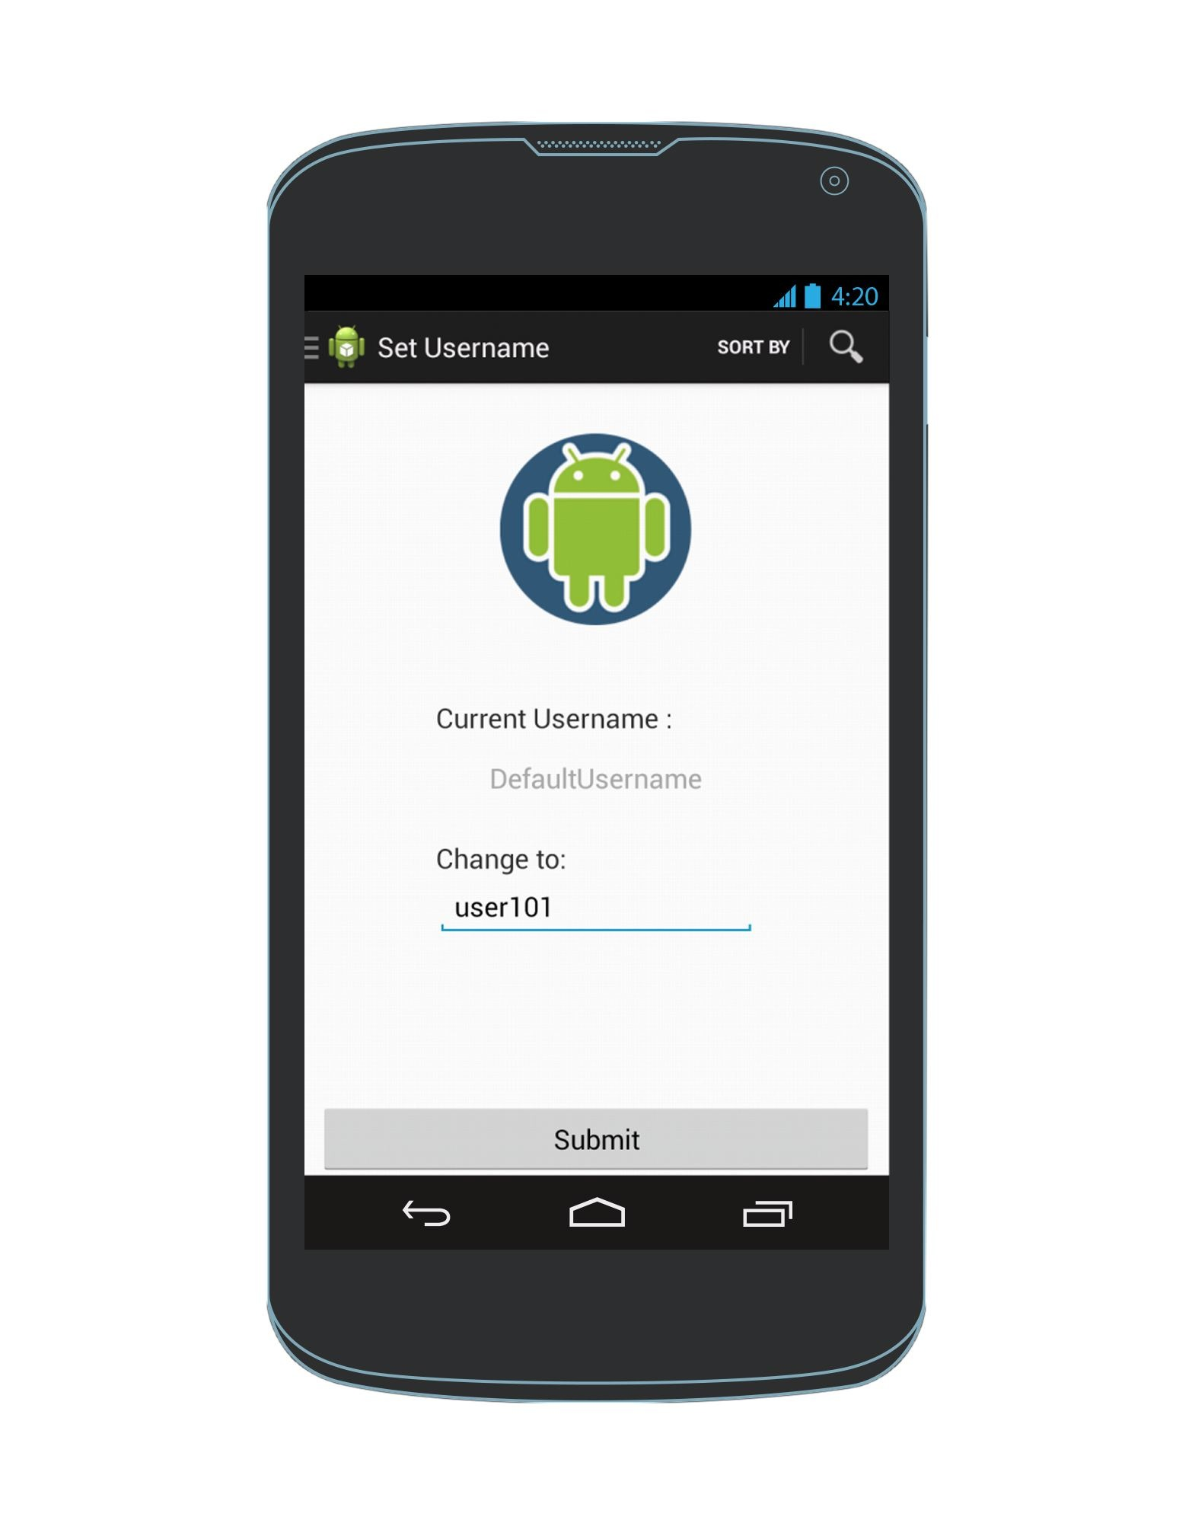
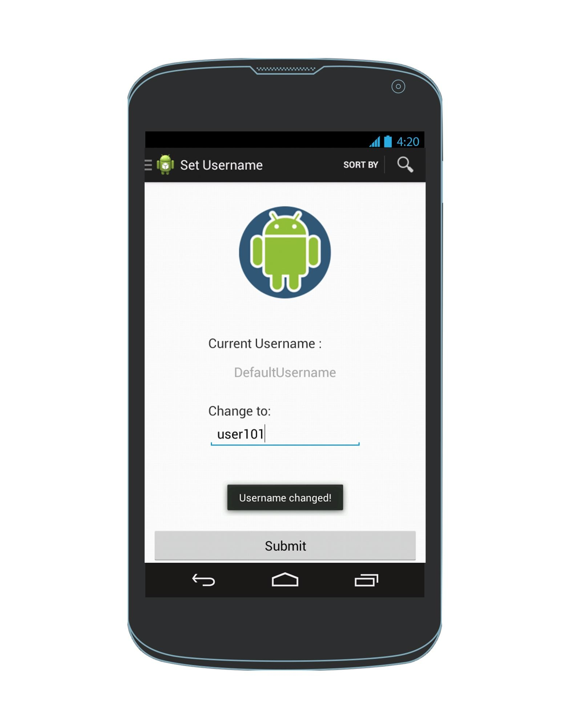
Set Username
HomeScreen
Navigation Drawer
Enter username in box

Slide 4
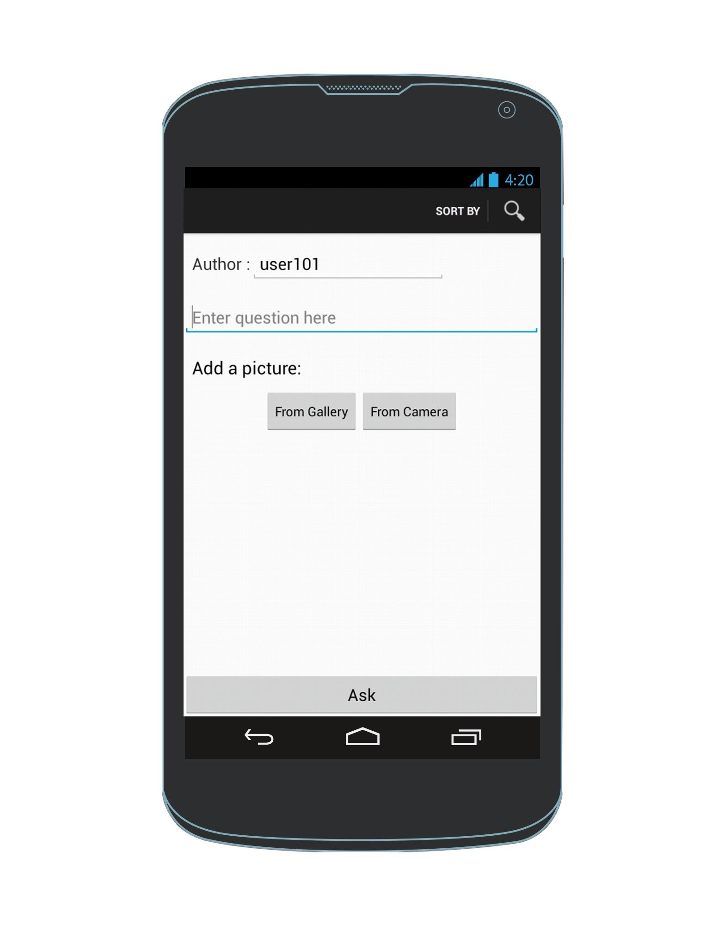
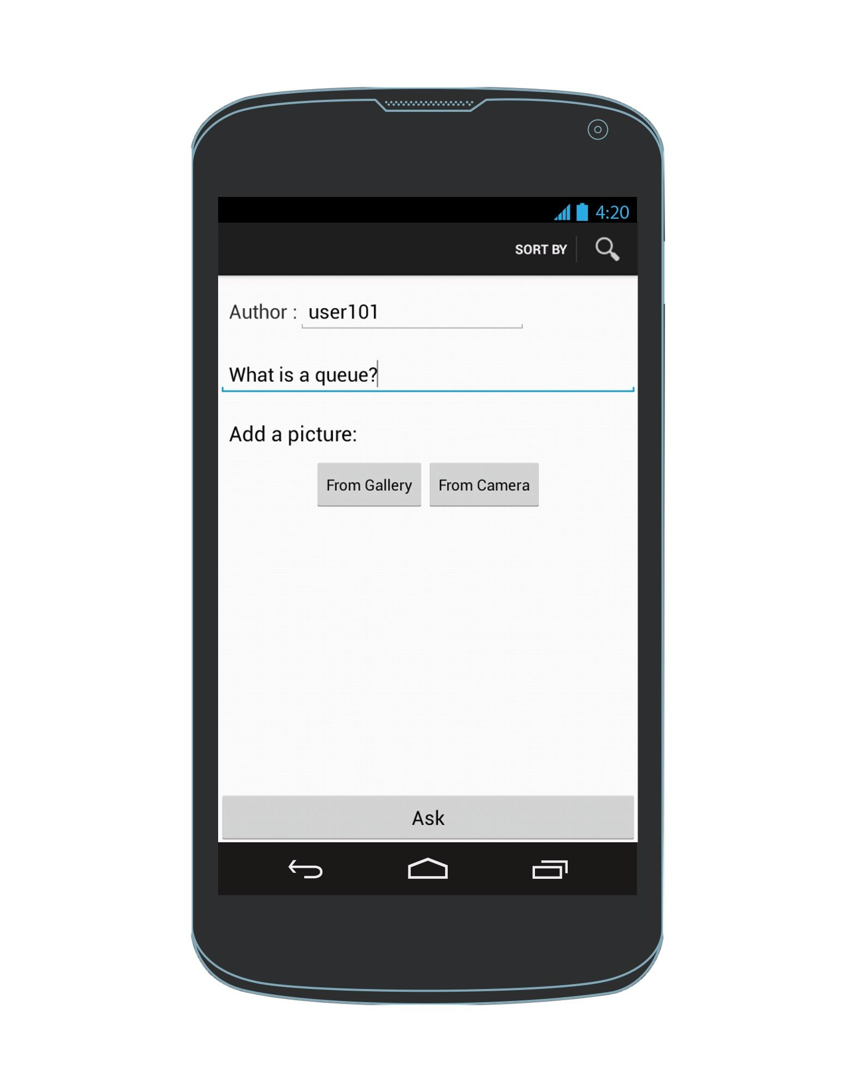
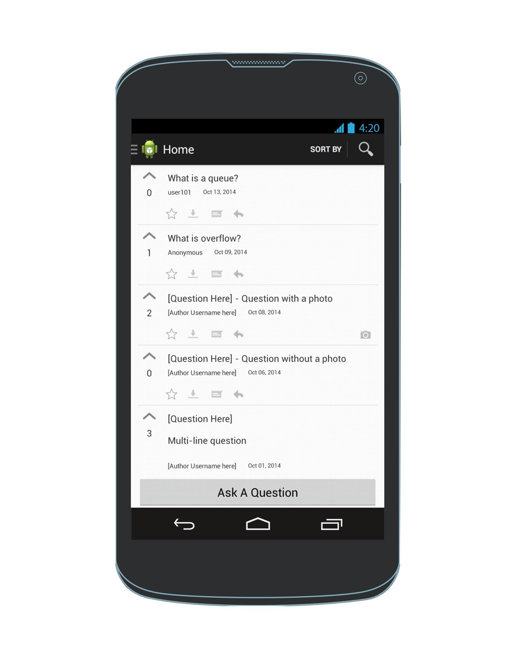
Ask a question
Questions are sorted by most recent by default
Enter a question
HomeScreen
AskAQuestionScreen
HomeScreen
Exception: To cancel & the AskAQuestion screen, click the back arrow

Slide 5
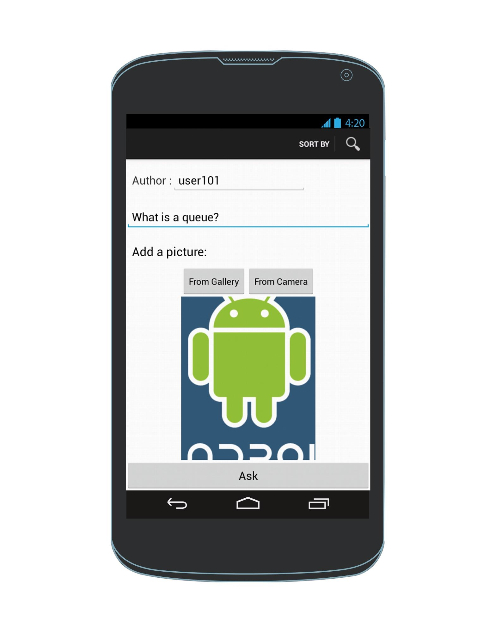

Alternative : Ask a question & attach a picture
Need to replace this with screenshot of camera emulator
Enter a question
Attach a photo
HomeScreen
Image Preview
AskAQuestionScreen

Slide 6
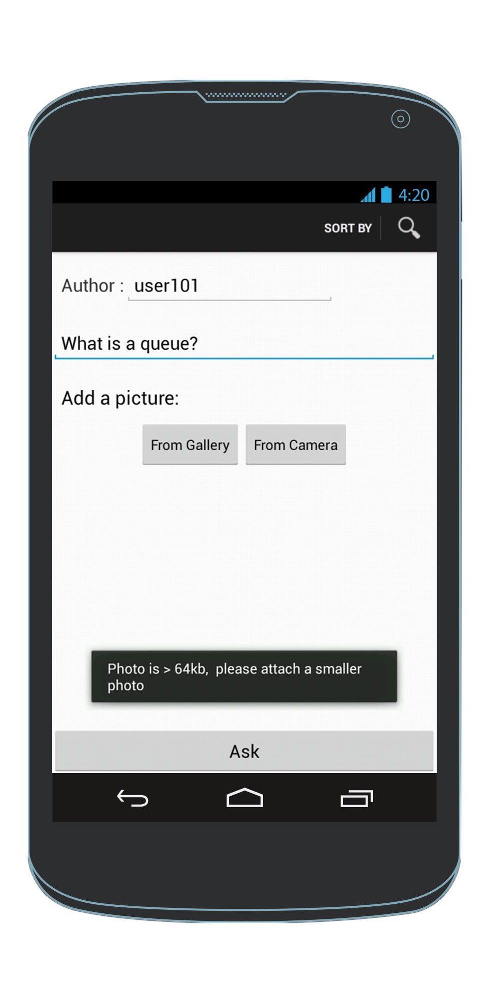
Exception : Photo is too large
Need to replace this with screenshot of camera emulator
Enter a question
Attach a photo
HomeScreen
AskAQuestionScreen
Photo is large than 64 kb. Returns to AskAQuestionScreen
and lets user try again.

Slide 7
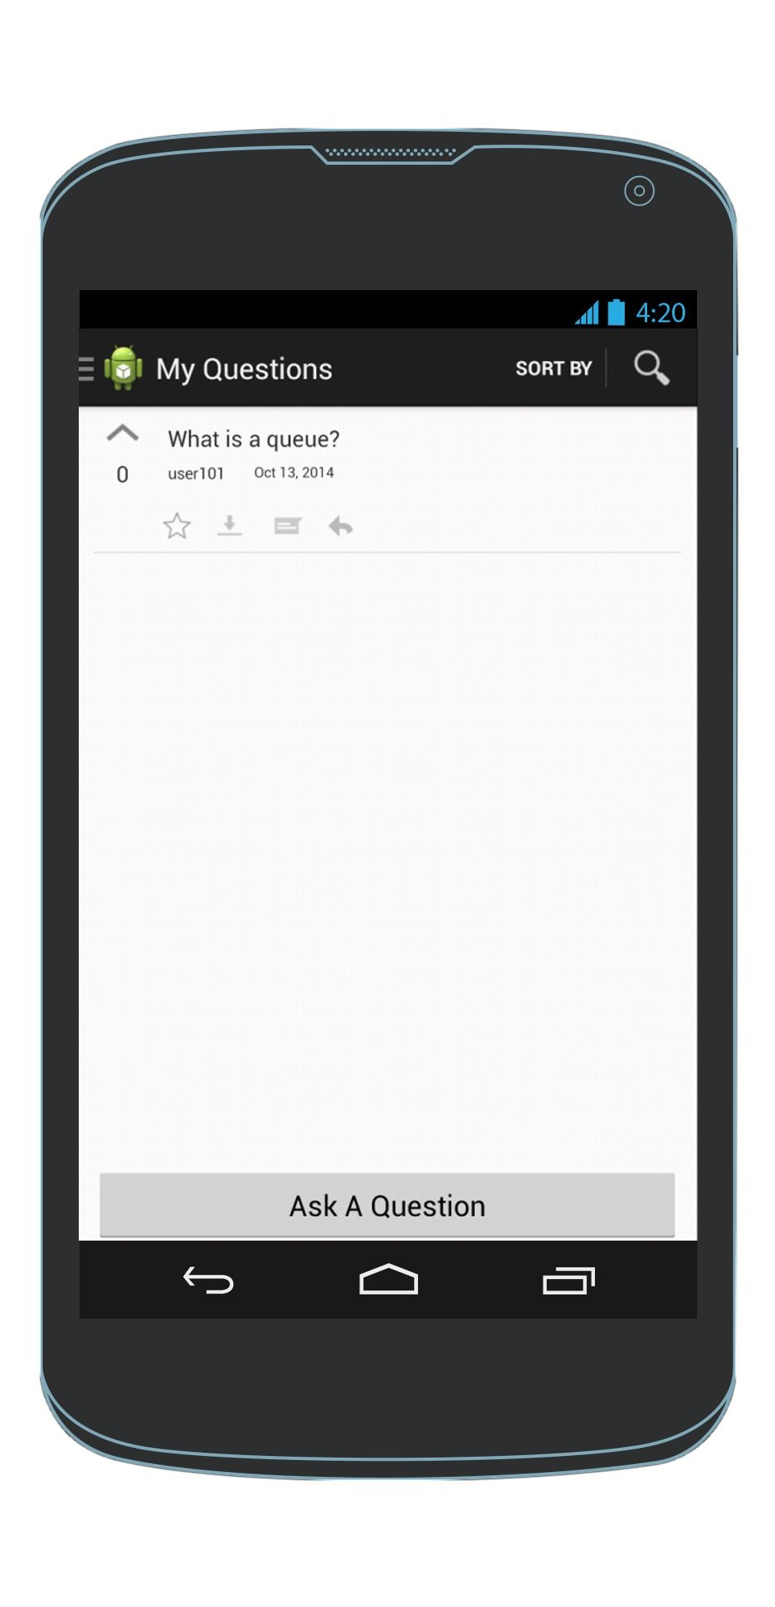
See the questions I asked
The device remembers the questions asked by a specific user
Navigation Drawer
My Questions View

Slide 8
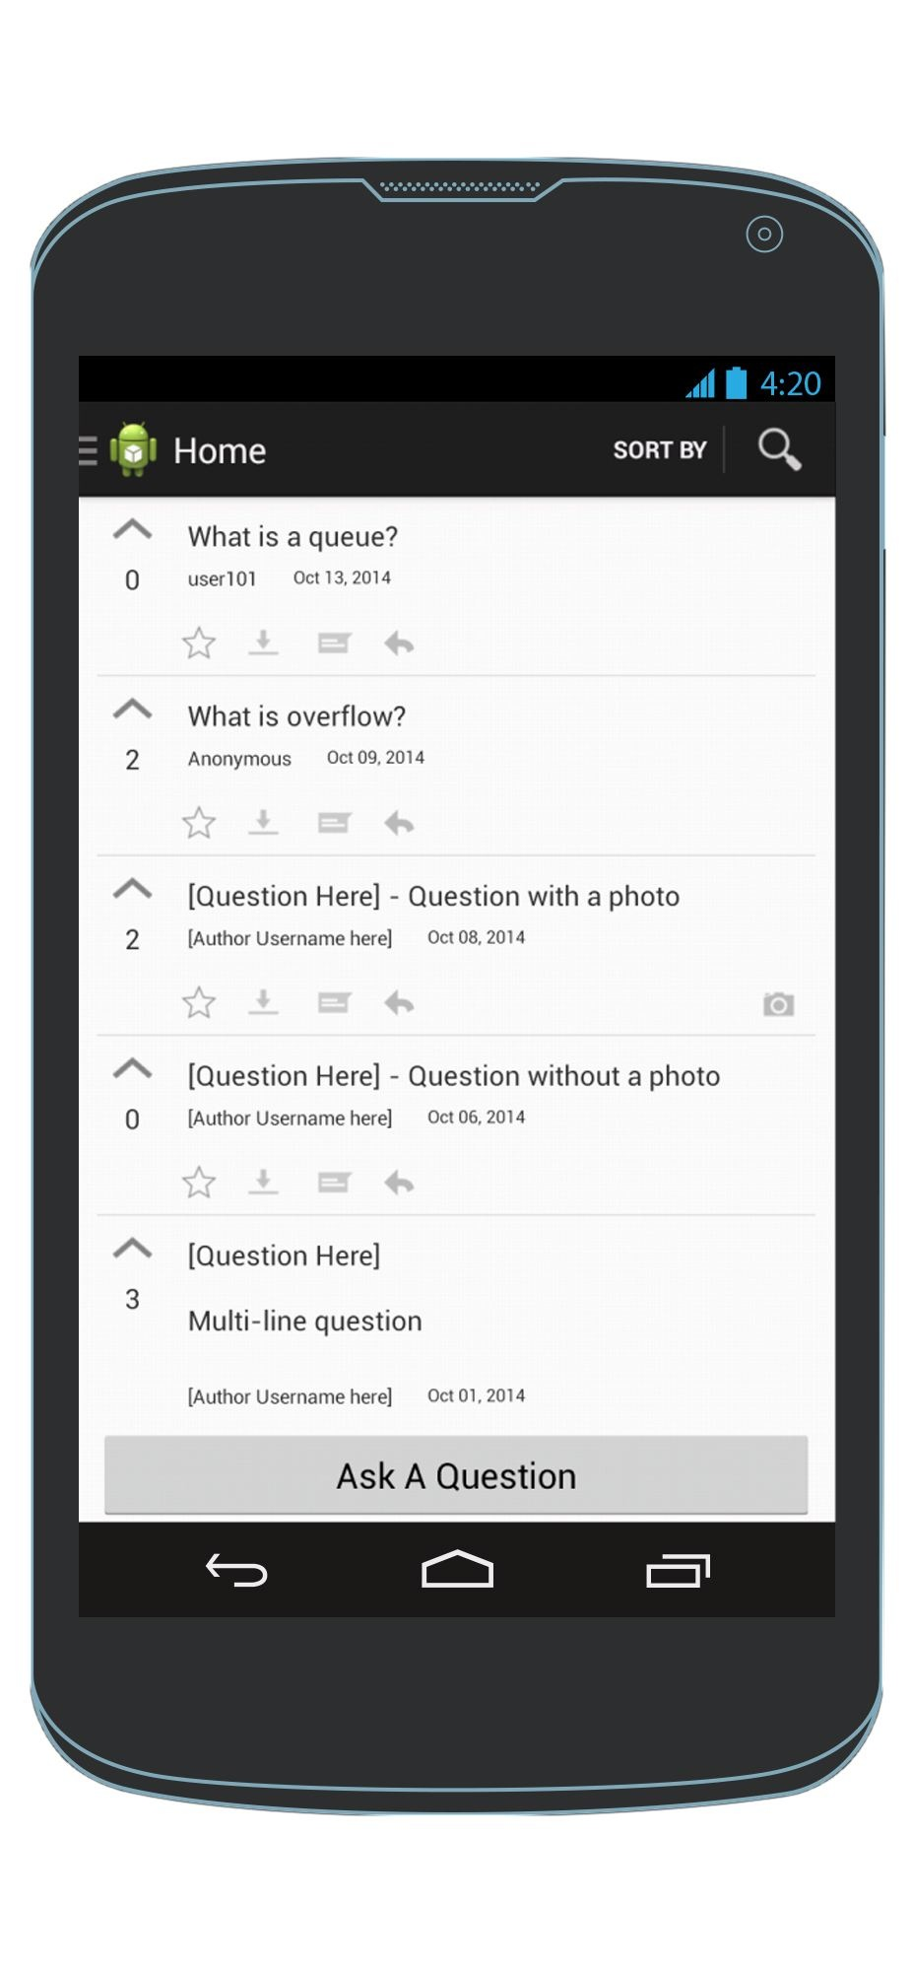
Upvote a question
HomeScreen
HomeScreen

Slide 9
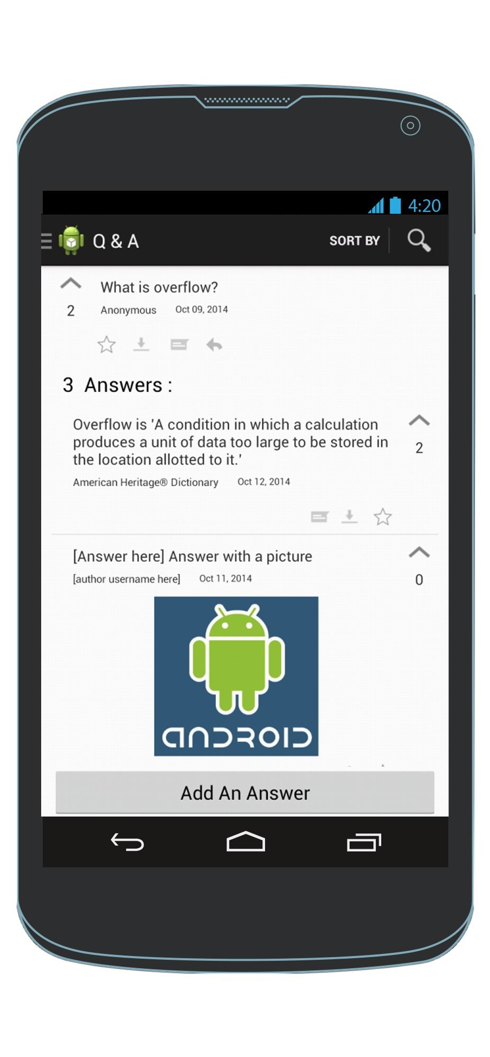
View a question & its answers
Answers are sorted by most recent by default
HomeScreen
Q & A View

Slide 10
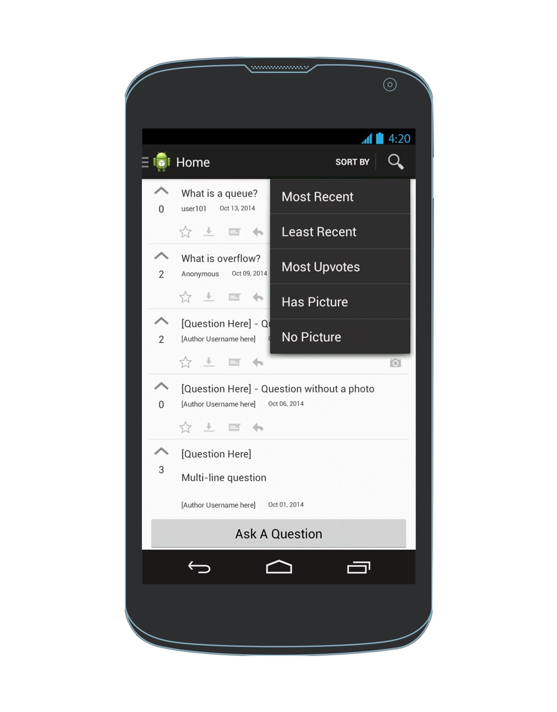
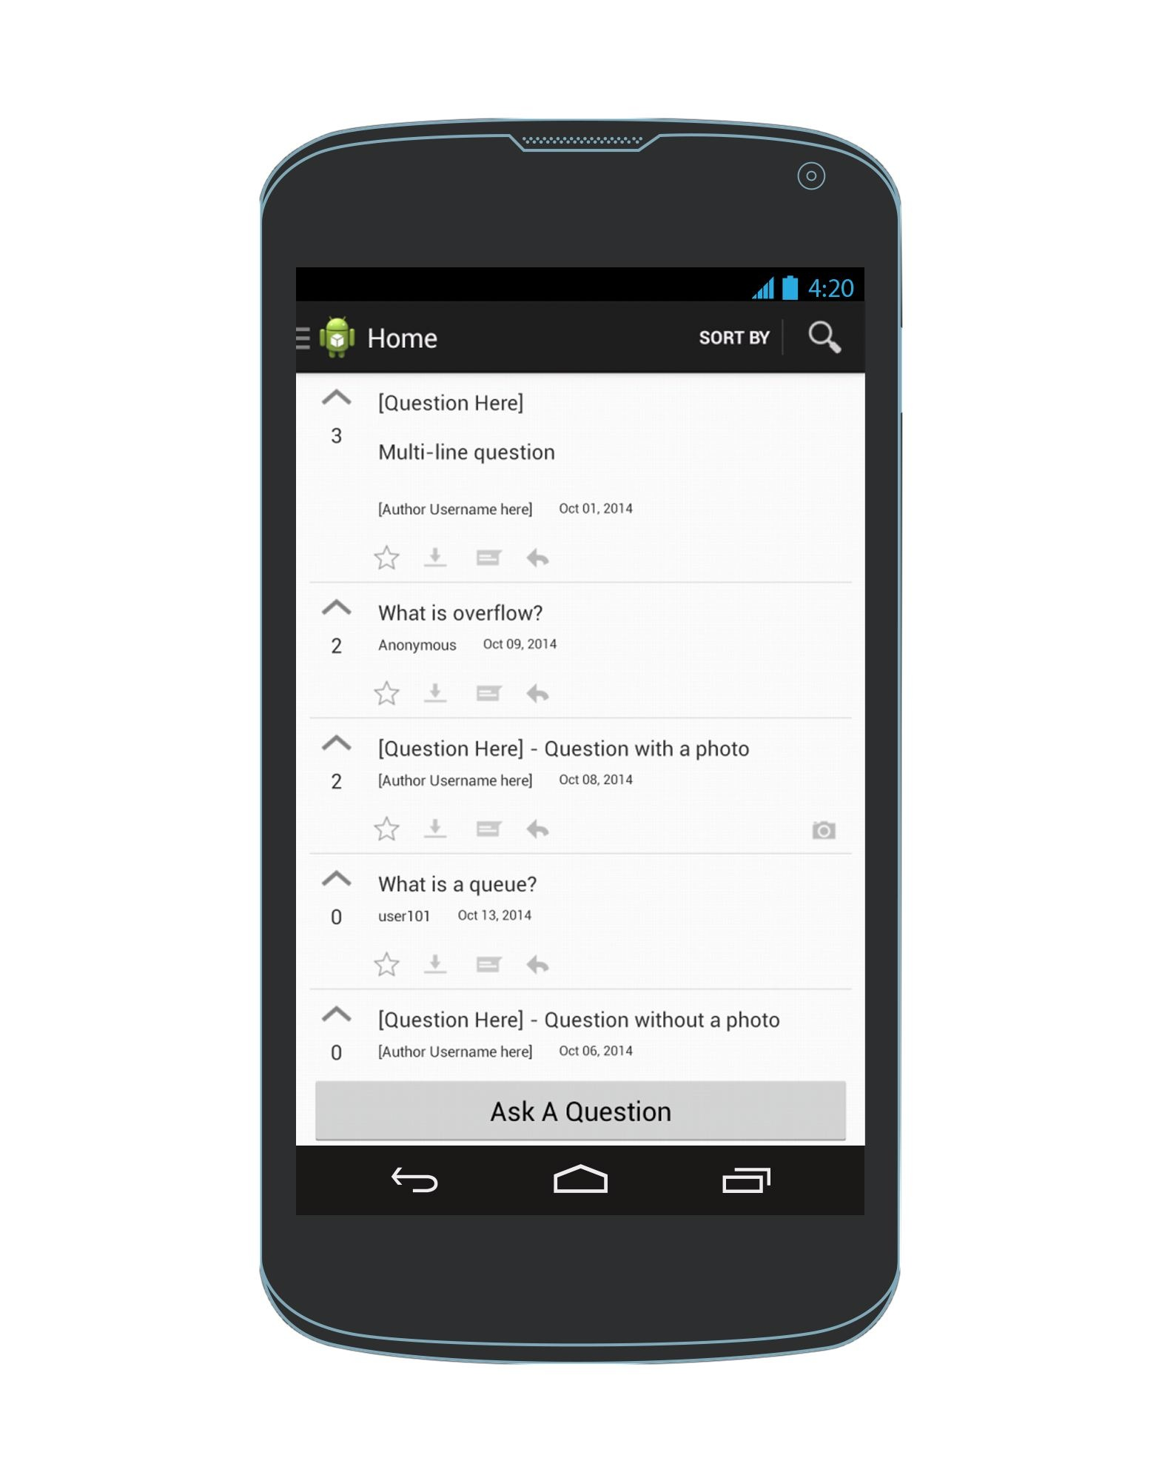
Sort questions by most upvoted (or least upvoted)
Questions are sorted by most upvoted
HomeScreen
HomeScreen
HomeScreen

Slide 11
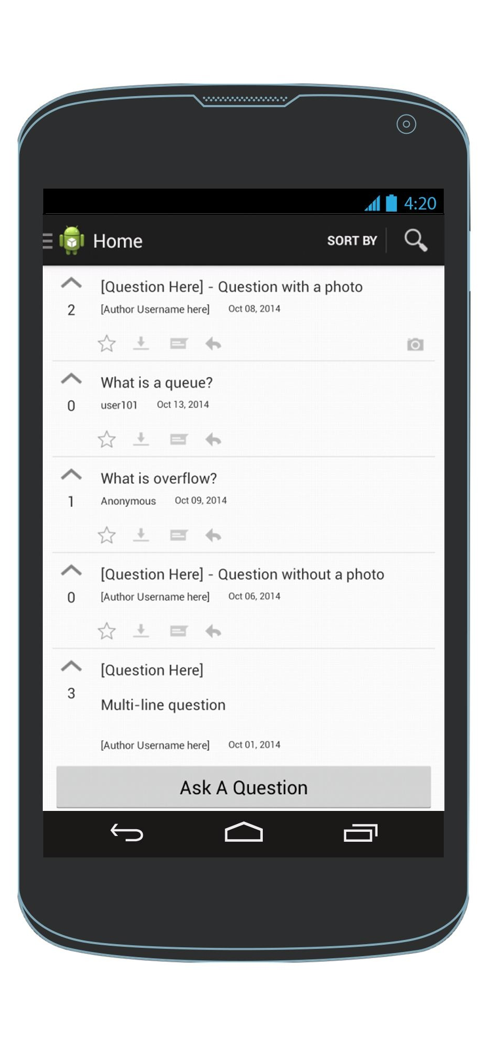
Sort questions by if they have(or don’t have) pictures
Questions with pictures are at the top
HomeScreen
HomeScreen
HomeScreen

Slide 12
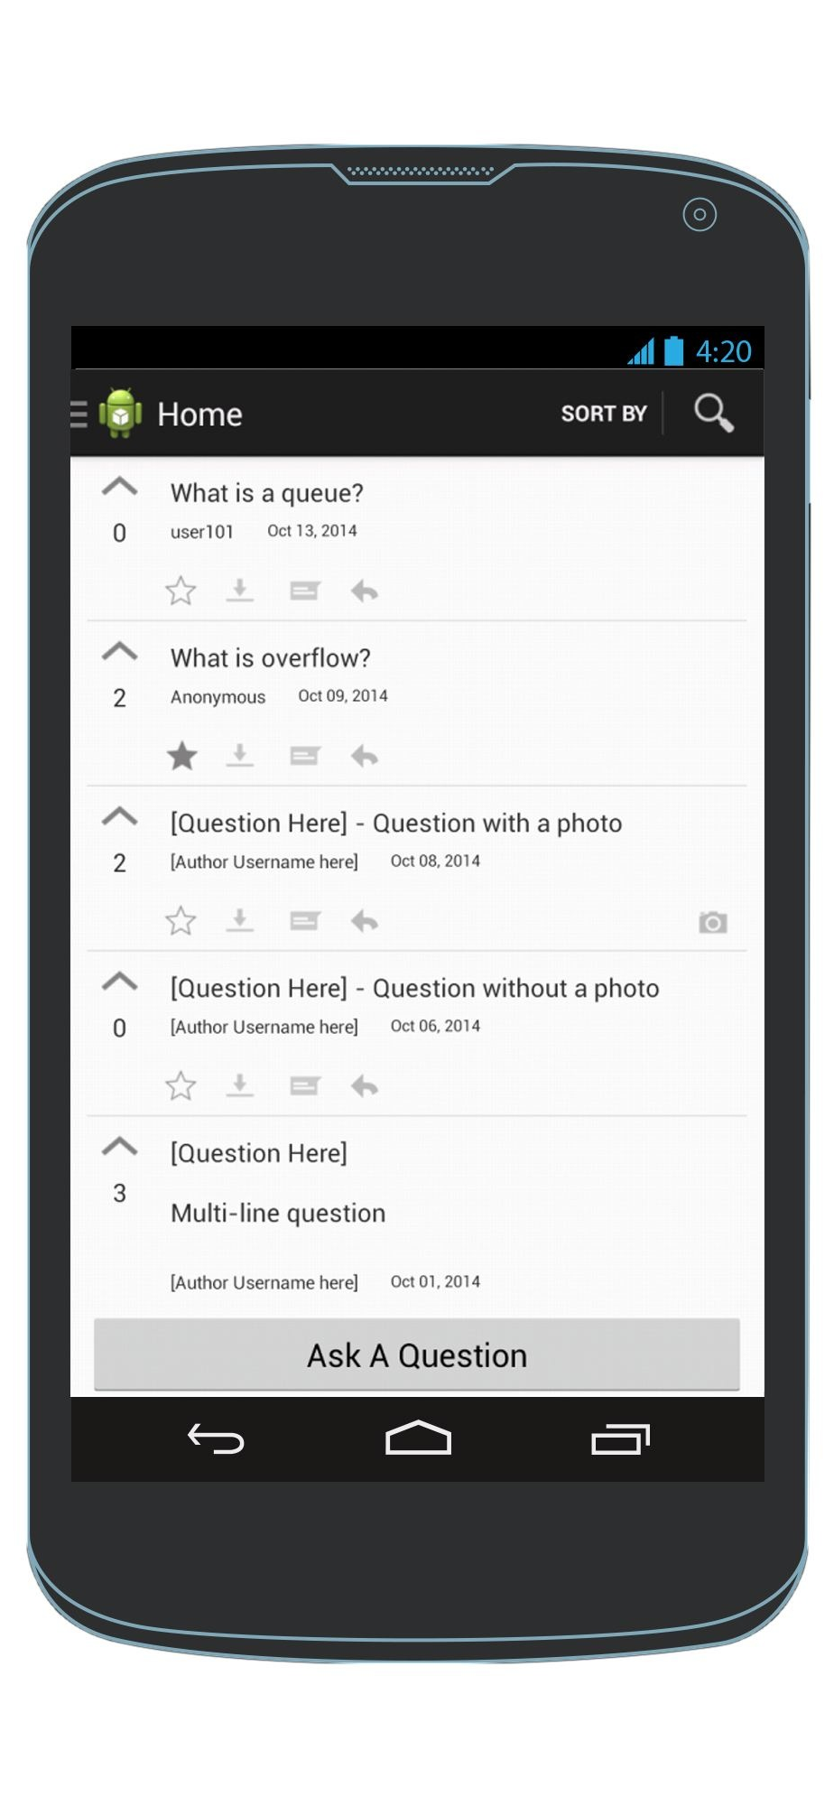
Save a question as a favorite
HomeScreen
HomeScreen

Slide 13
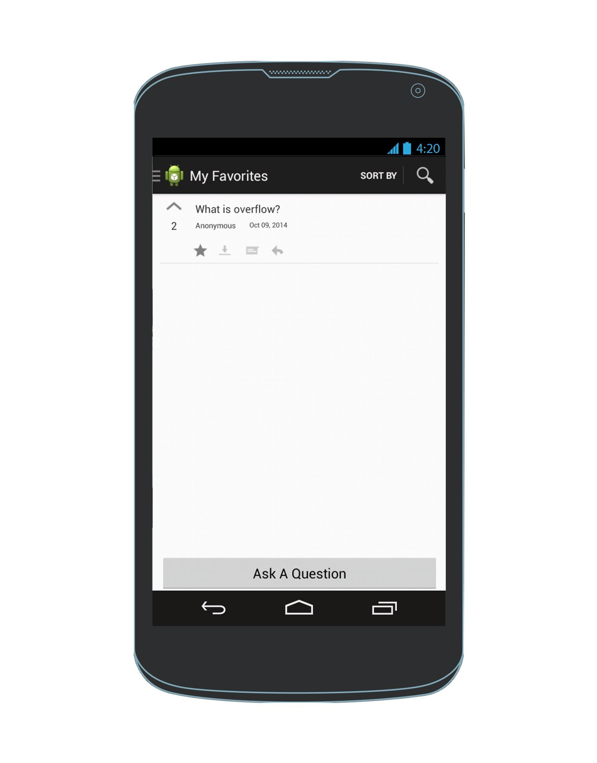
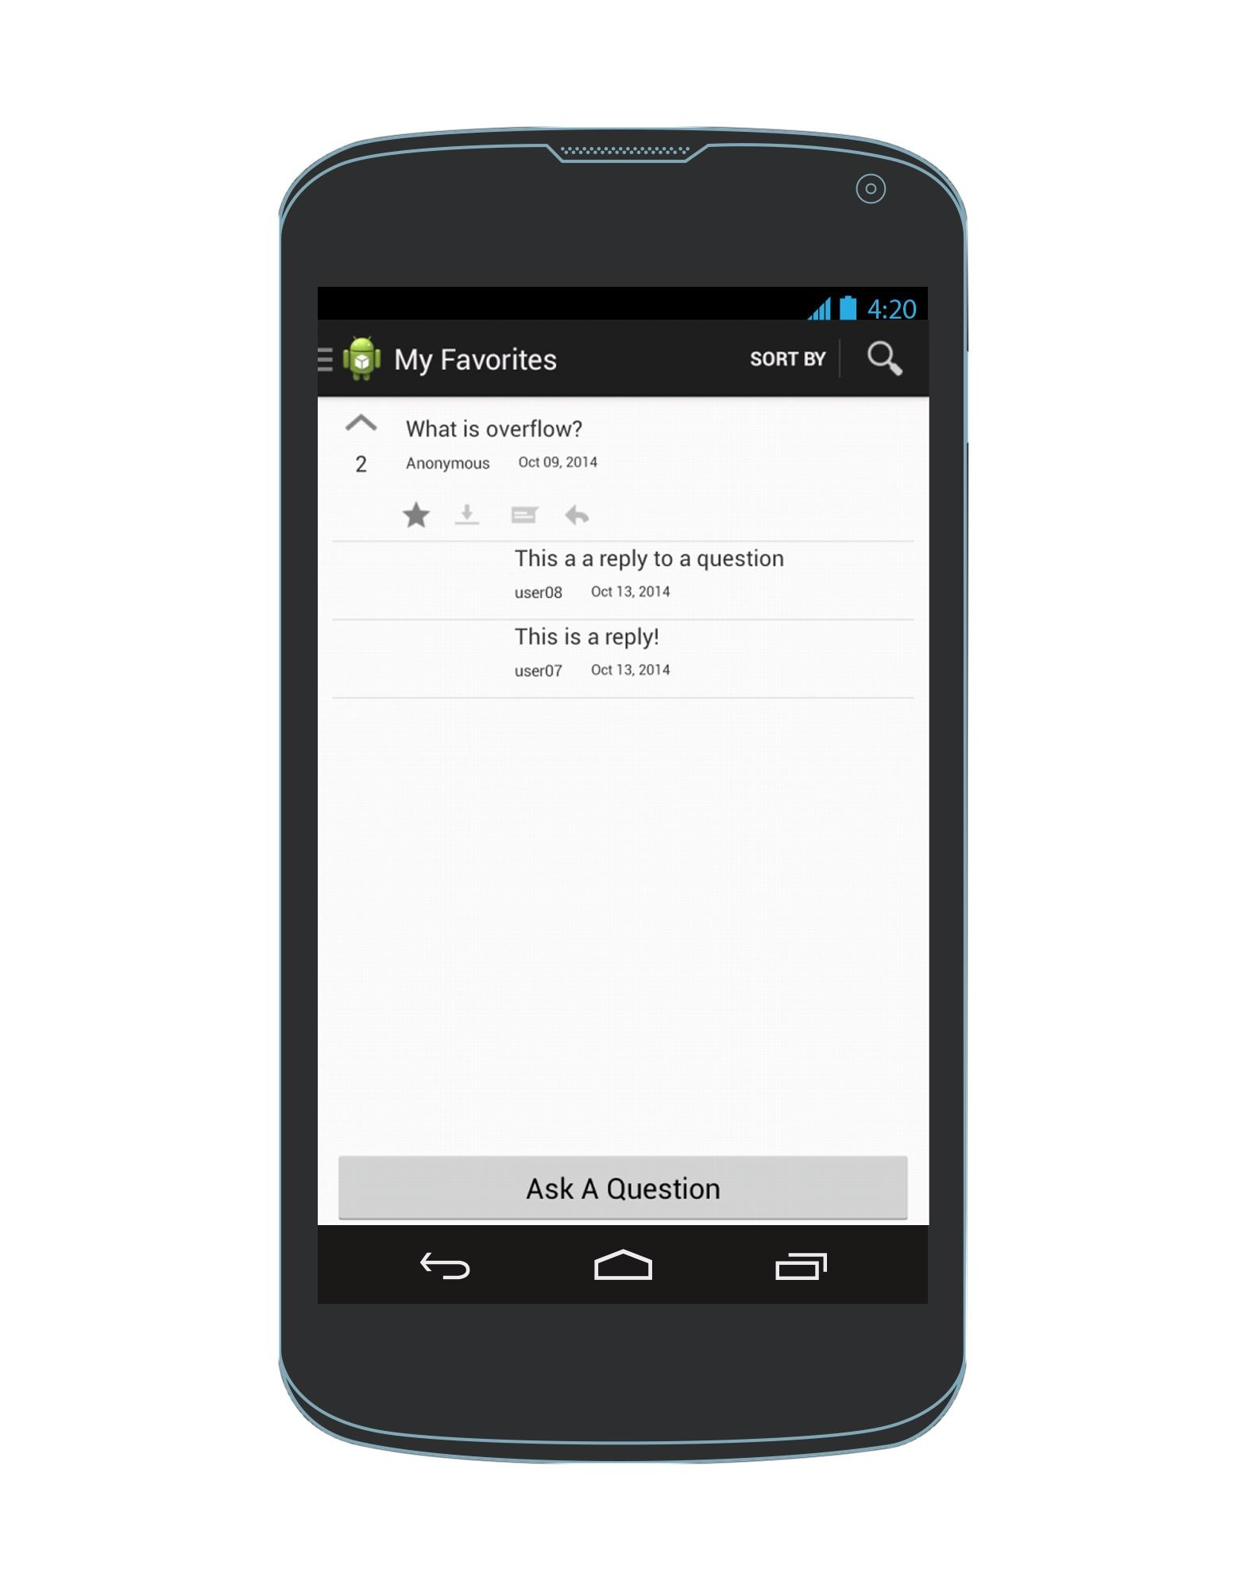
View questions that I’ve favorited and their replies
Available regardless of network connectivity.
Click again to remove from favourites
Navigation Drawer
My Favorites View
My Favorites View

Slide 14

Mark a question/answer for offline reading
HomeScreen
HomeScreen

Slide 15
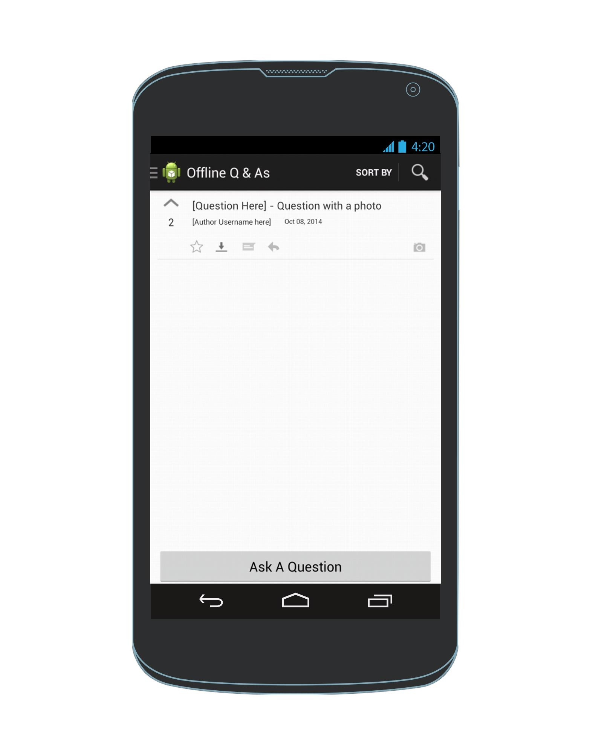
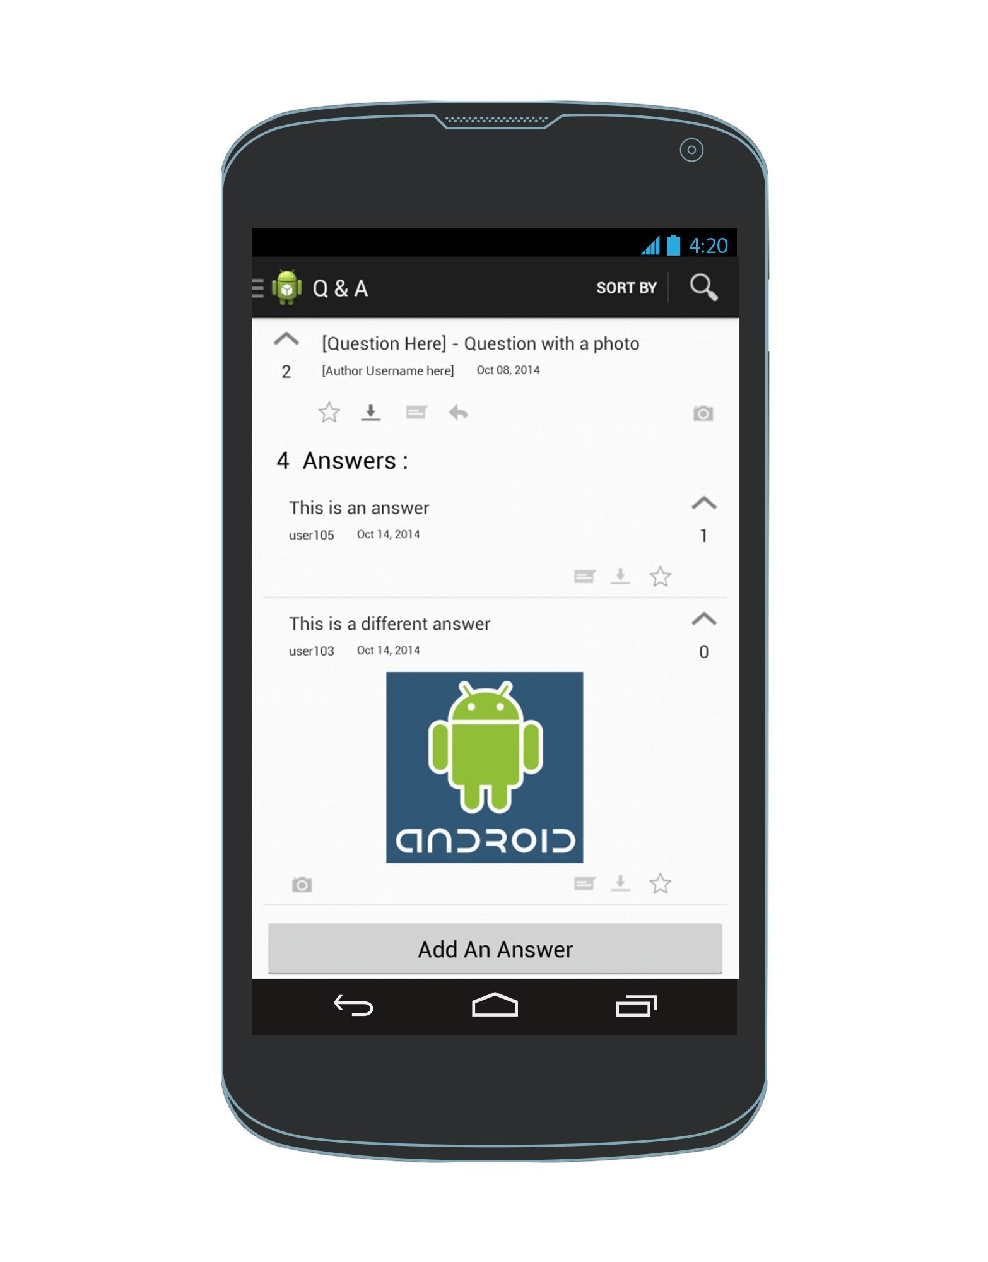

View questions & answers that I’ve indicated I want to read
Available regardless of network connectivity.
Offline Questions
Click again to remove from offline reading list
Navigation Drawer
Offline Q & As View
Offline Q & As View

Slide 16
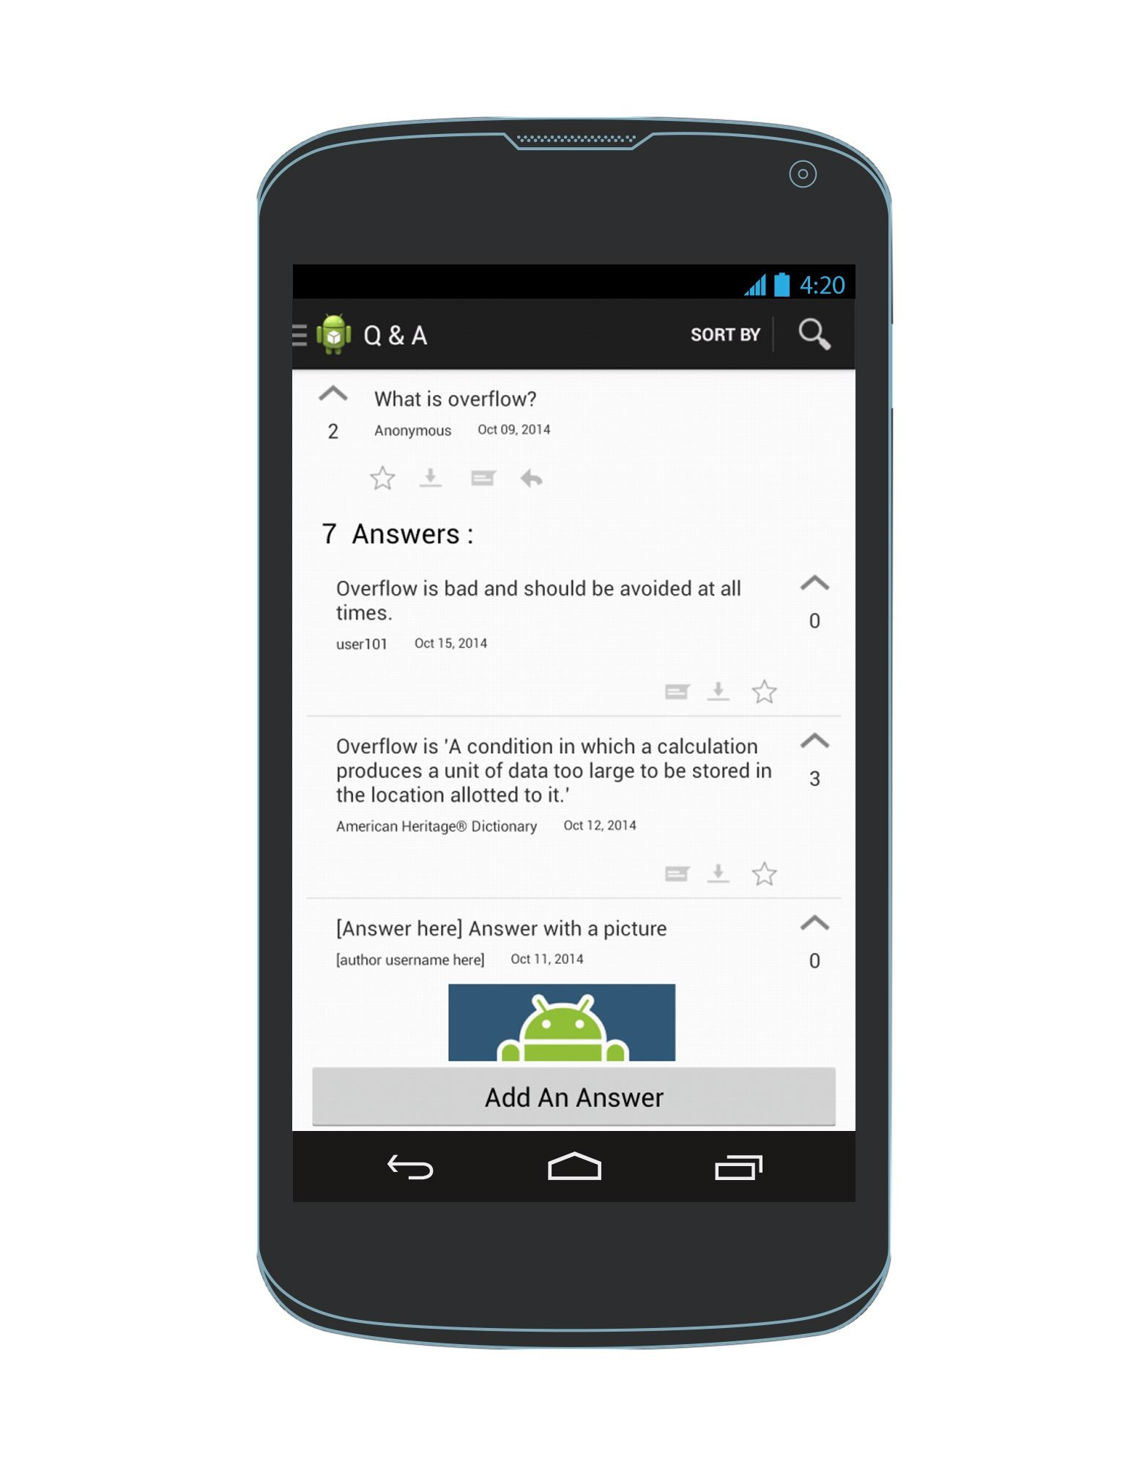
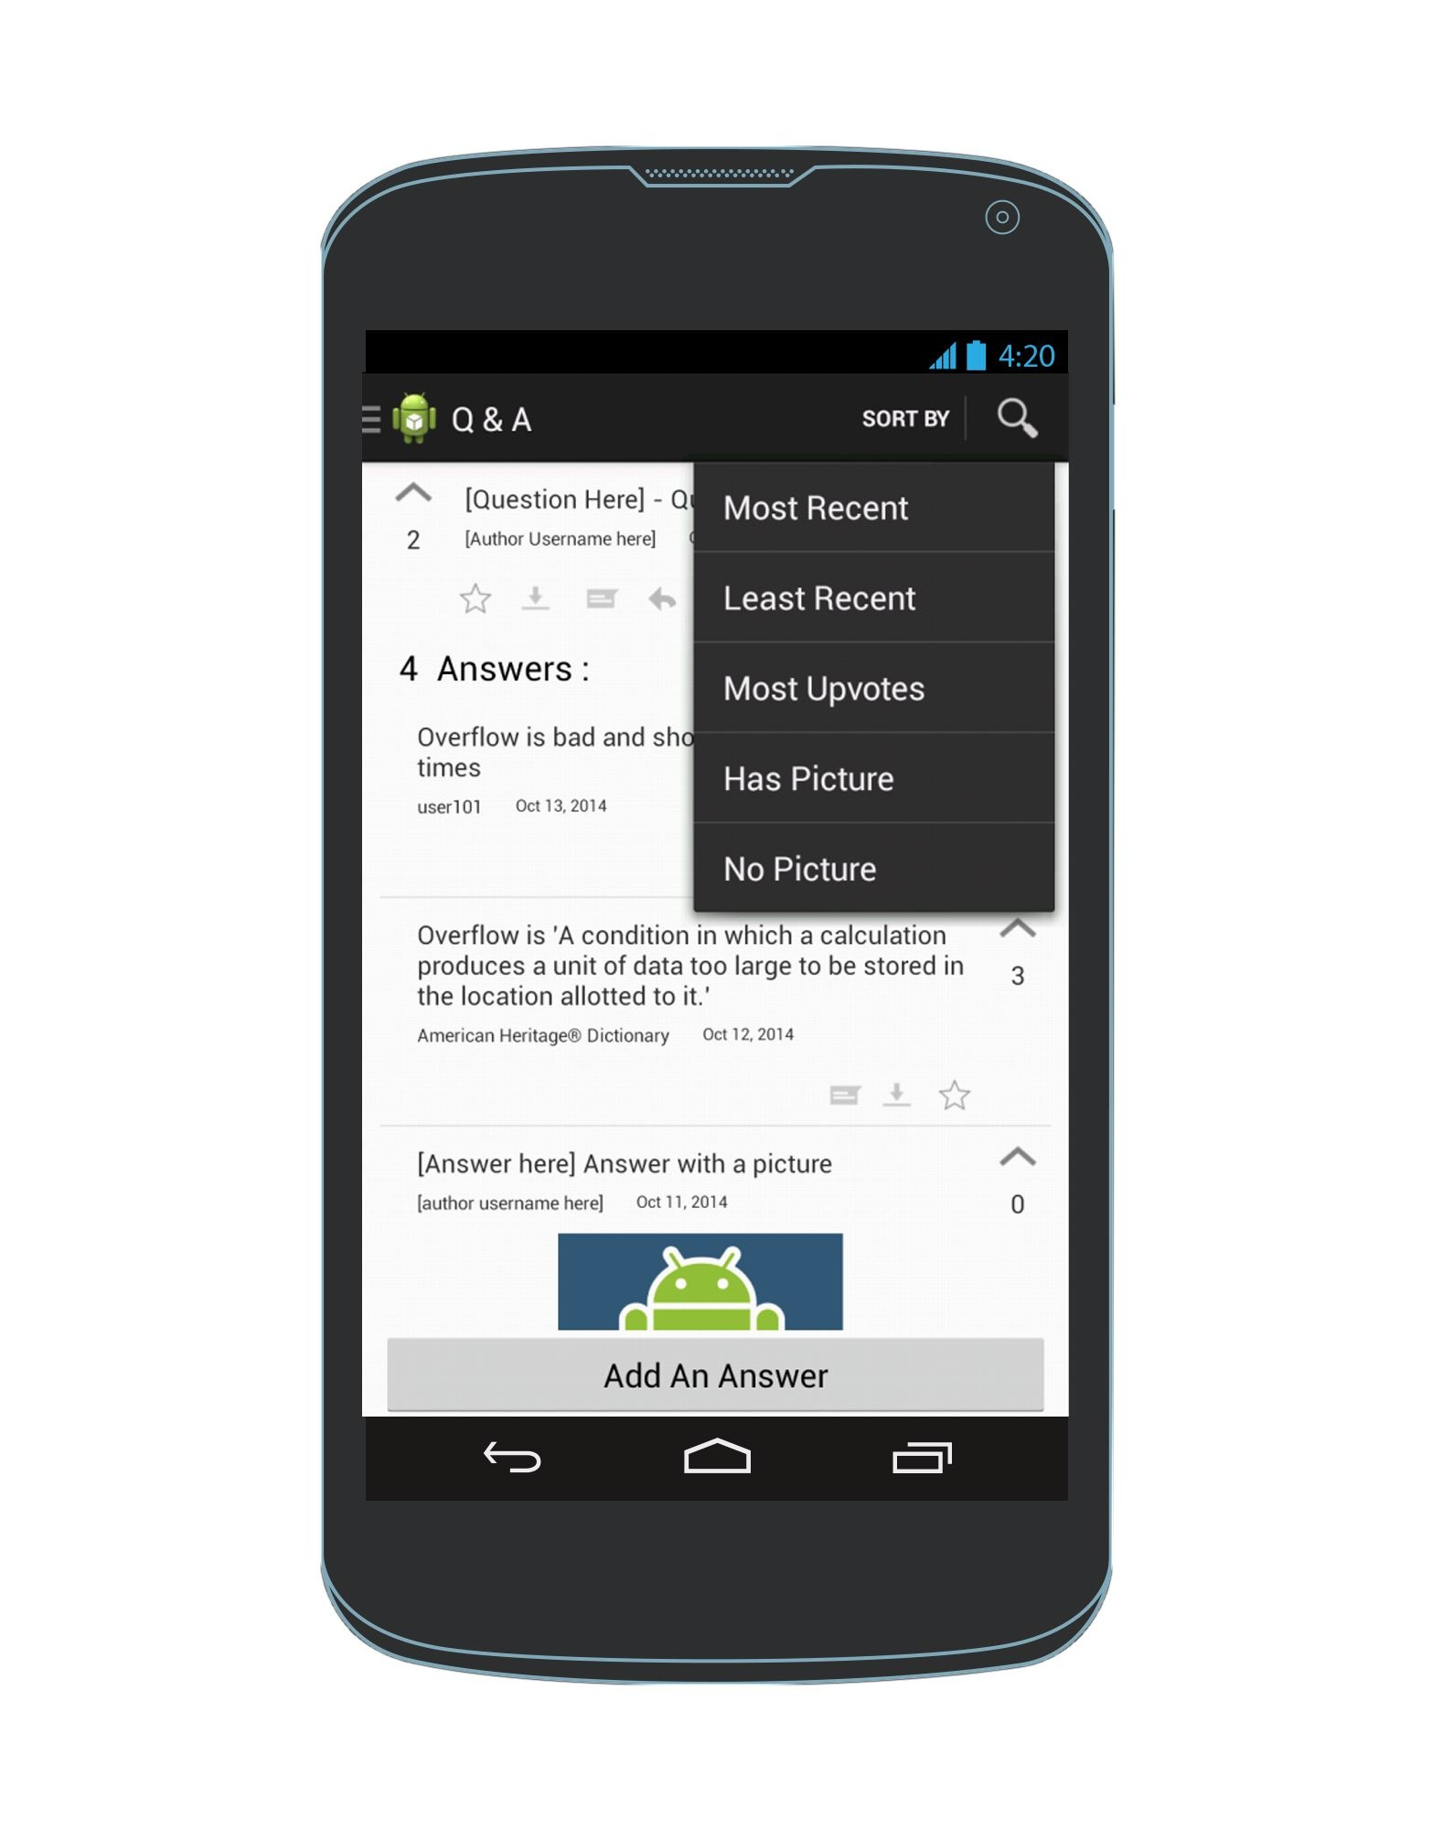
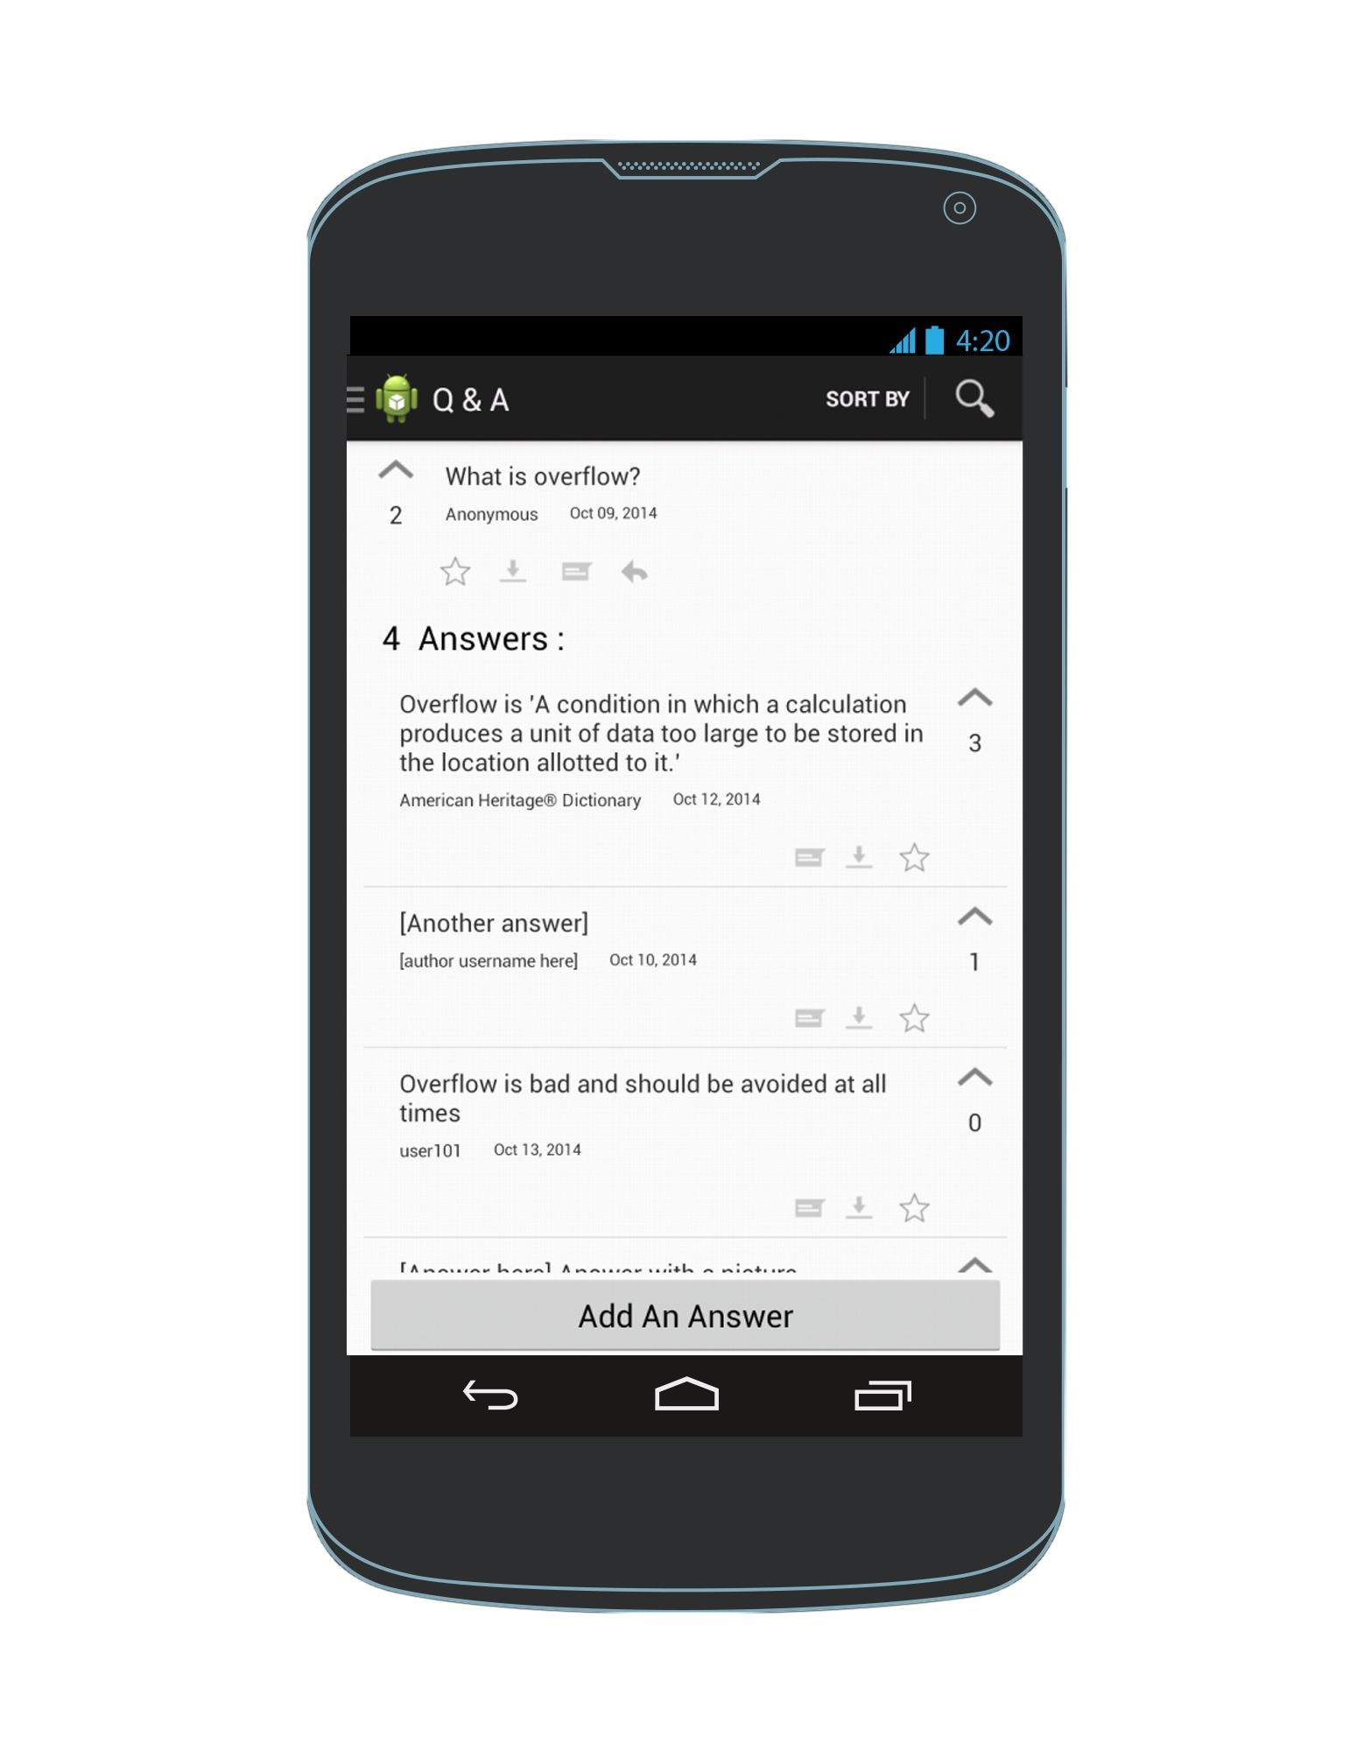
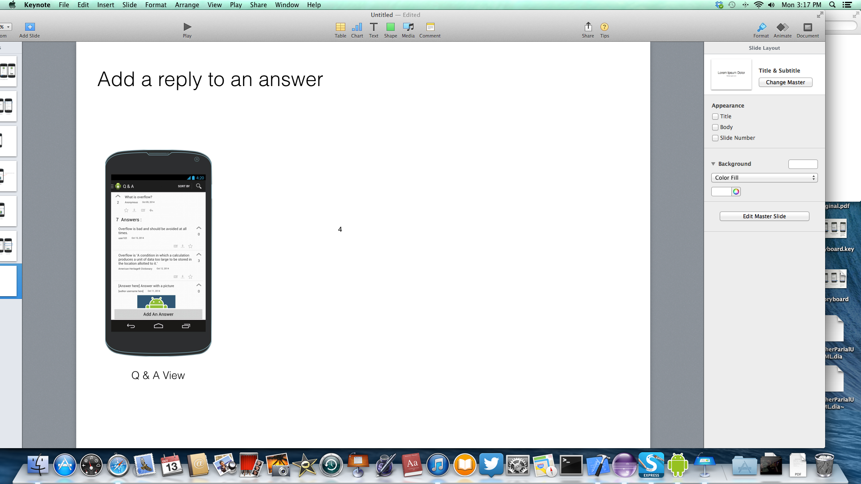
Sort answers by most upvoted (or least upvoted)
Answers are sorted by most upvoted
Q & A View
Q & A View
Q & A View

Slide 17
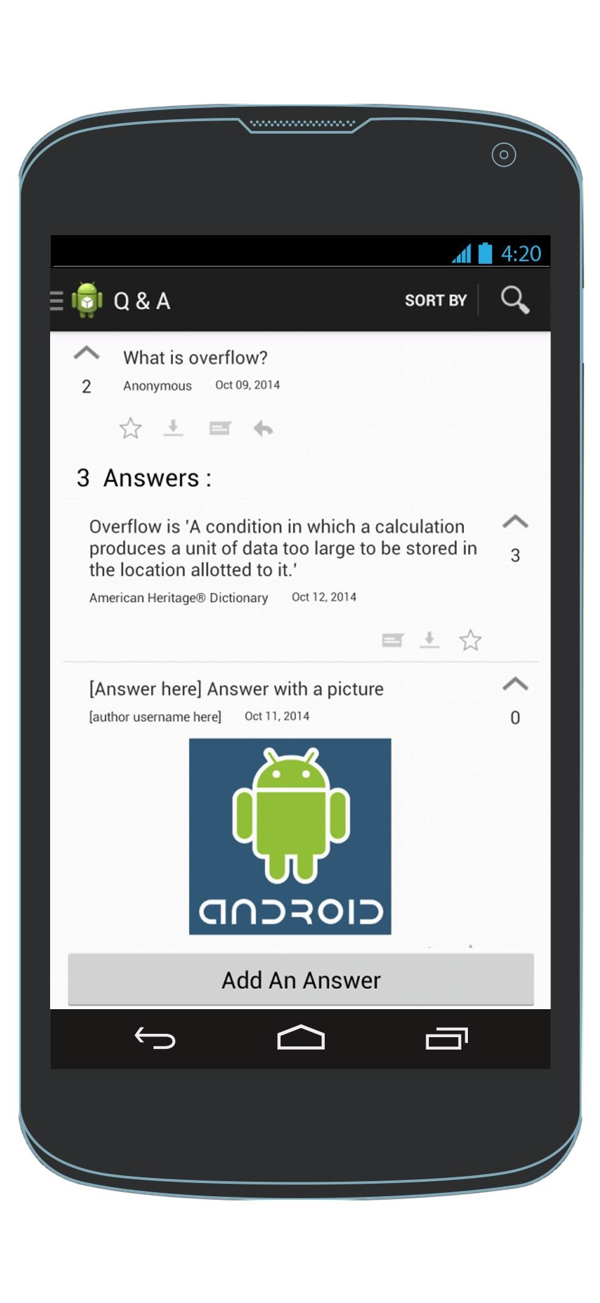
Upvote an answer
Q & A View
Q & A View

Slide 18
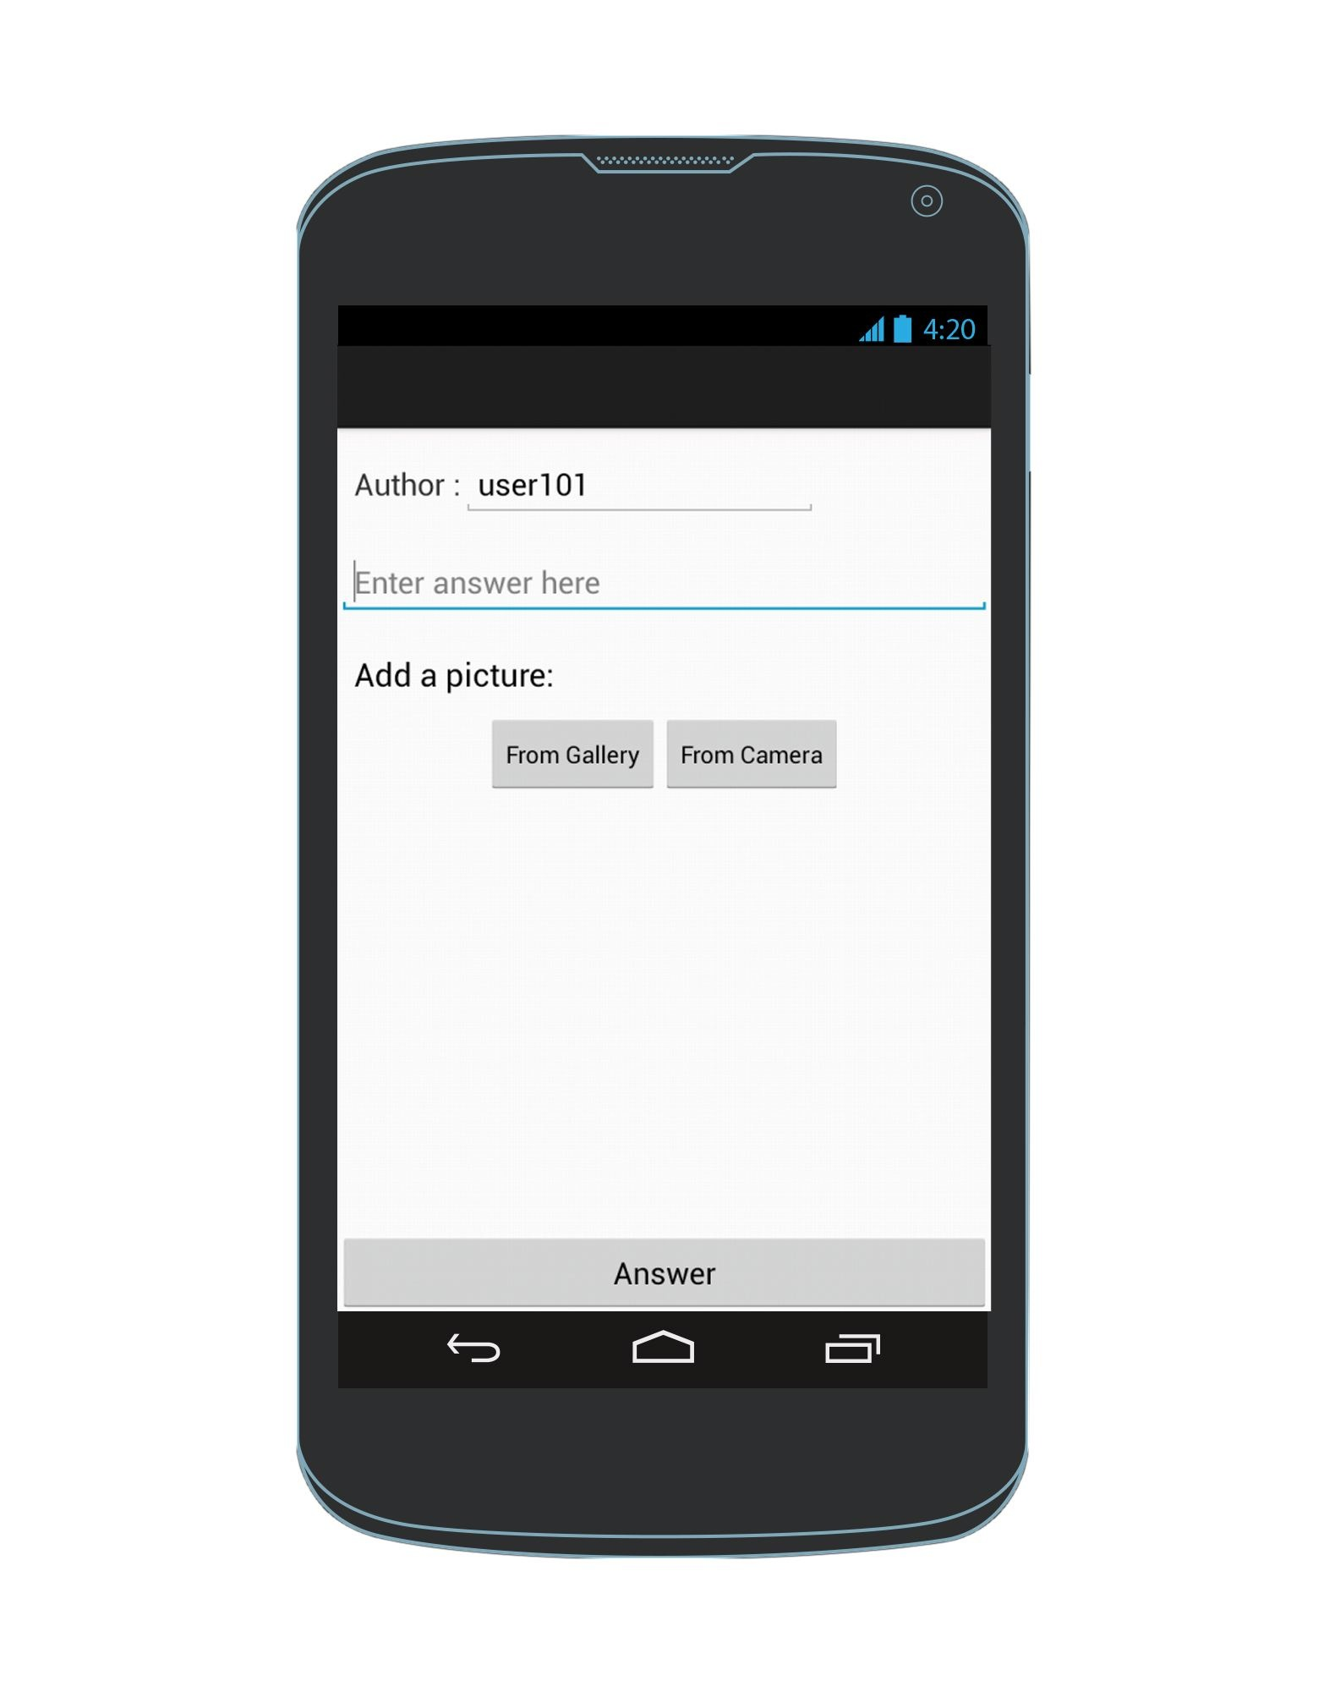
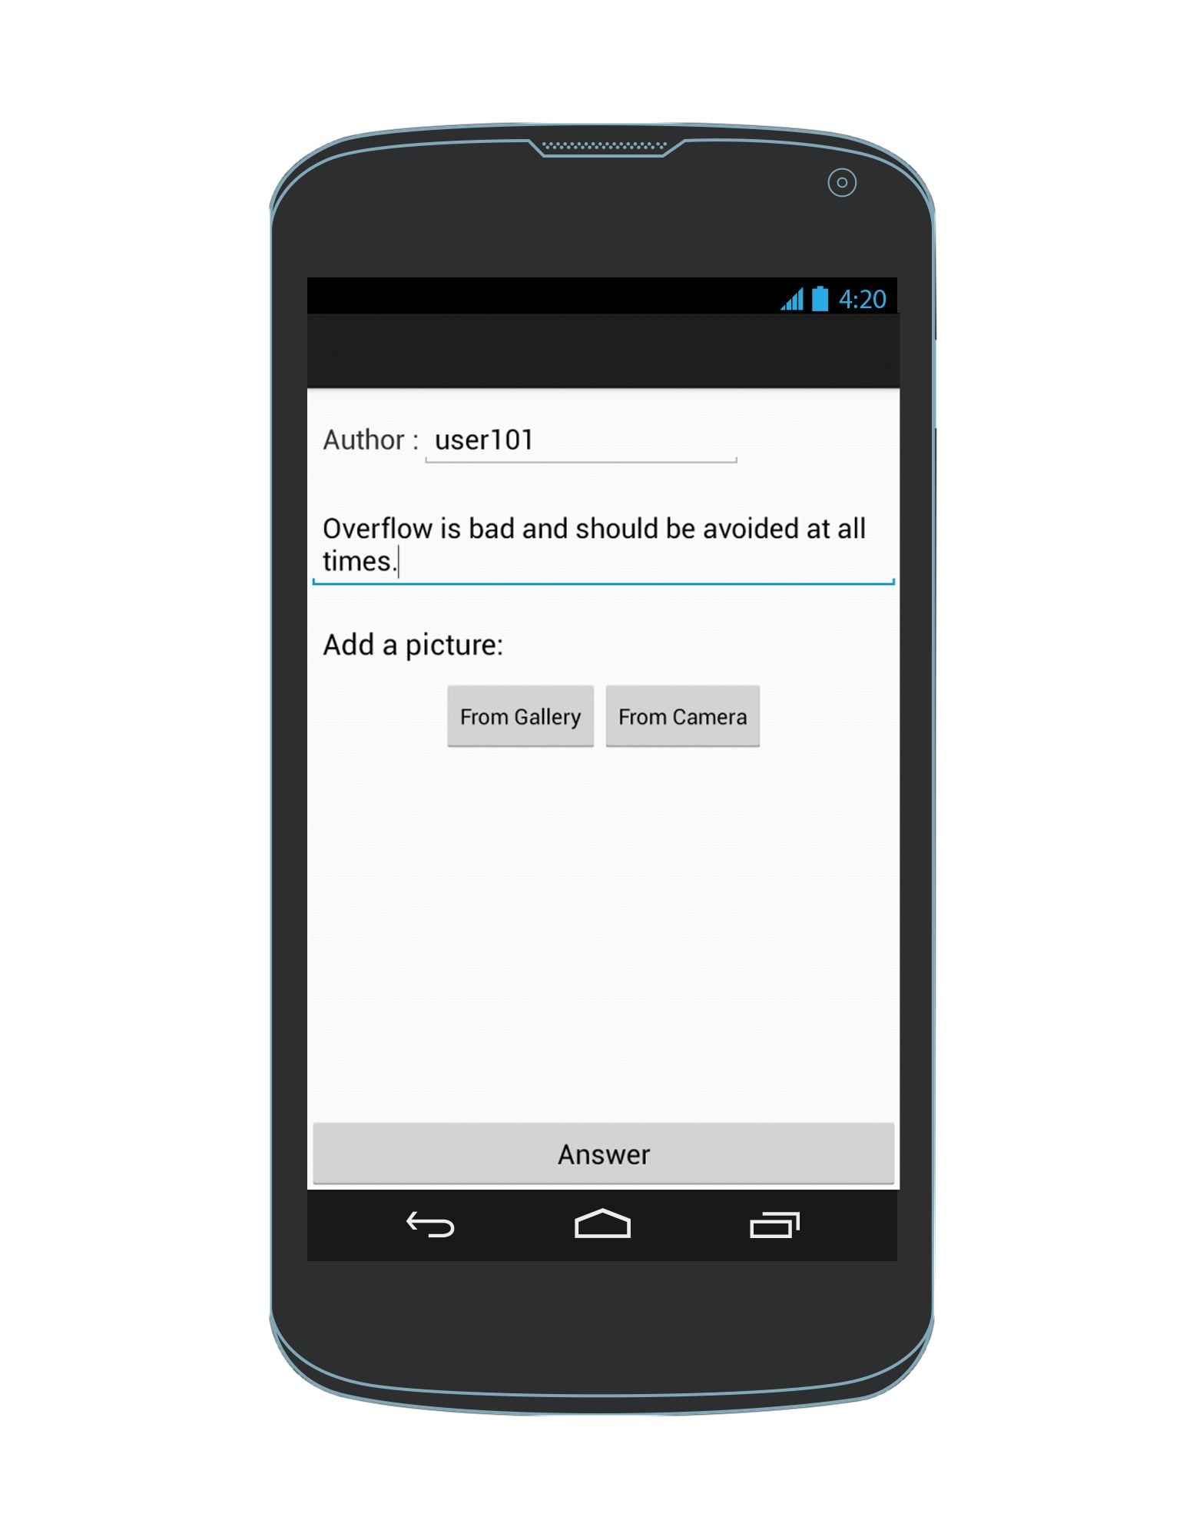
Add an answer
Enter an answer
Q & A View
AddAnAnswer Screen
Q & A View
Exception: To cancel & the AddAnAnswer screen, click the back arrow

Slide 19
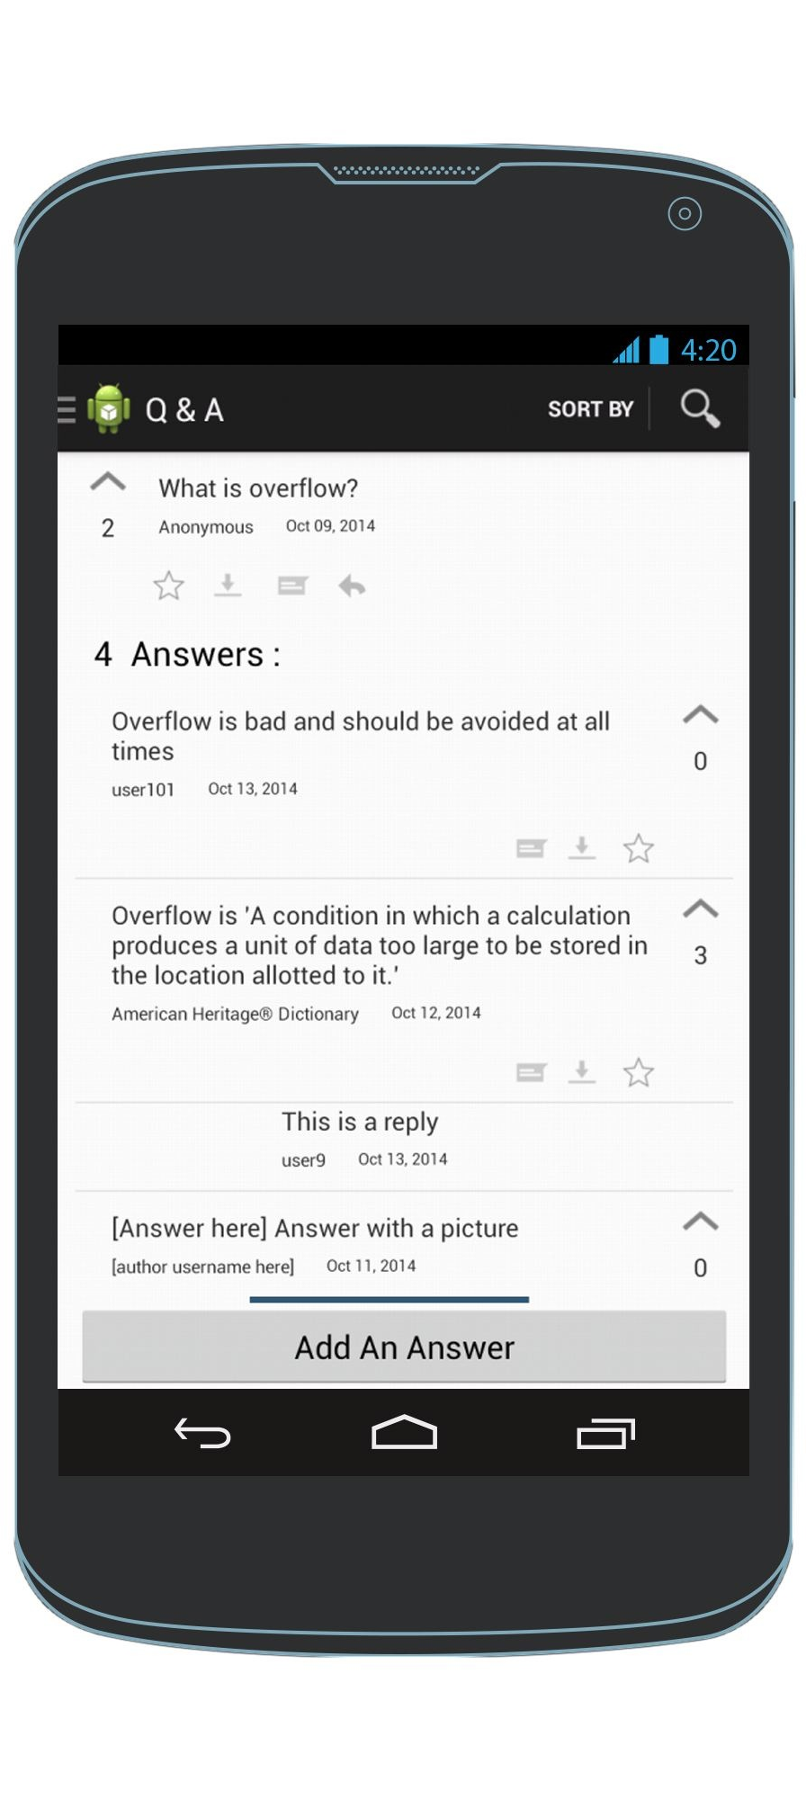
View the replies of an answer
To see replies
To hide replies
Q & A View
Q & A View
Q & A View

Slide 20
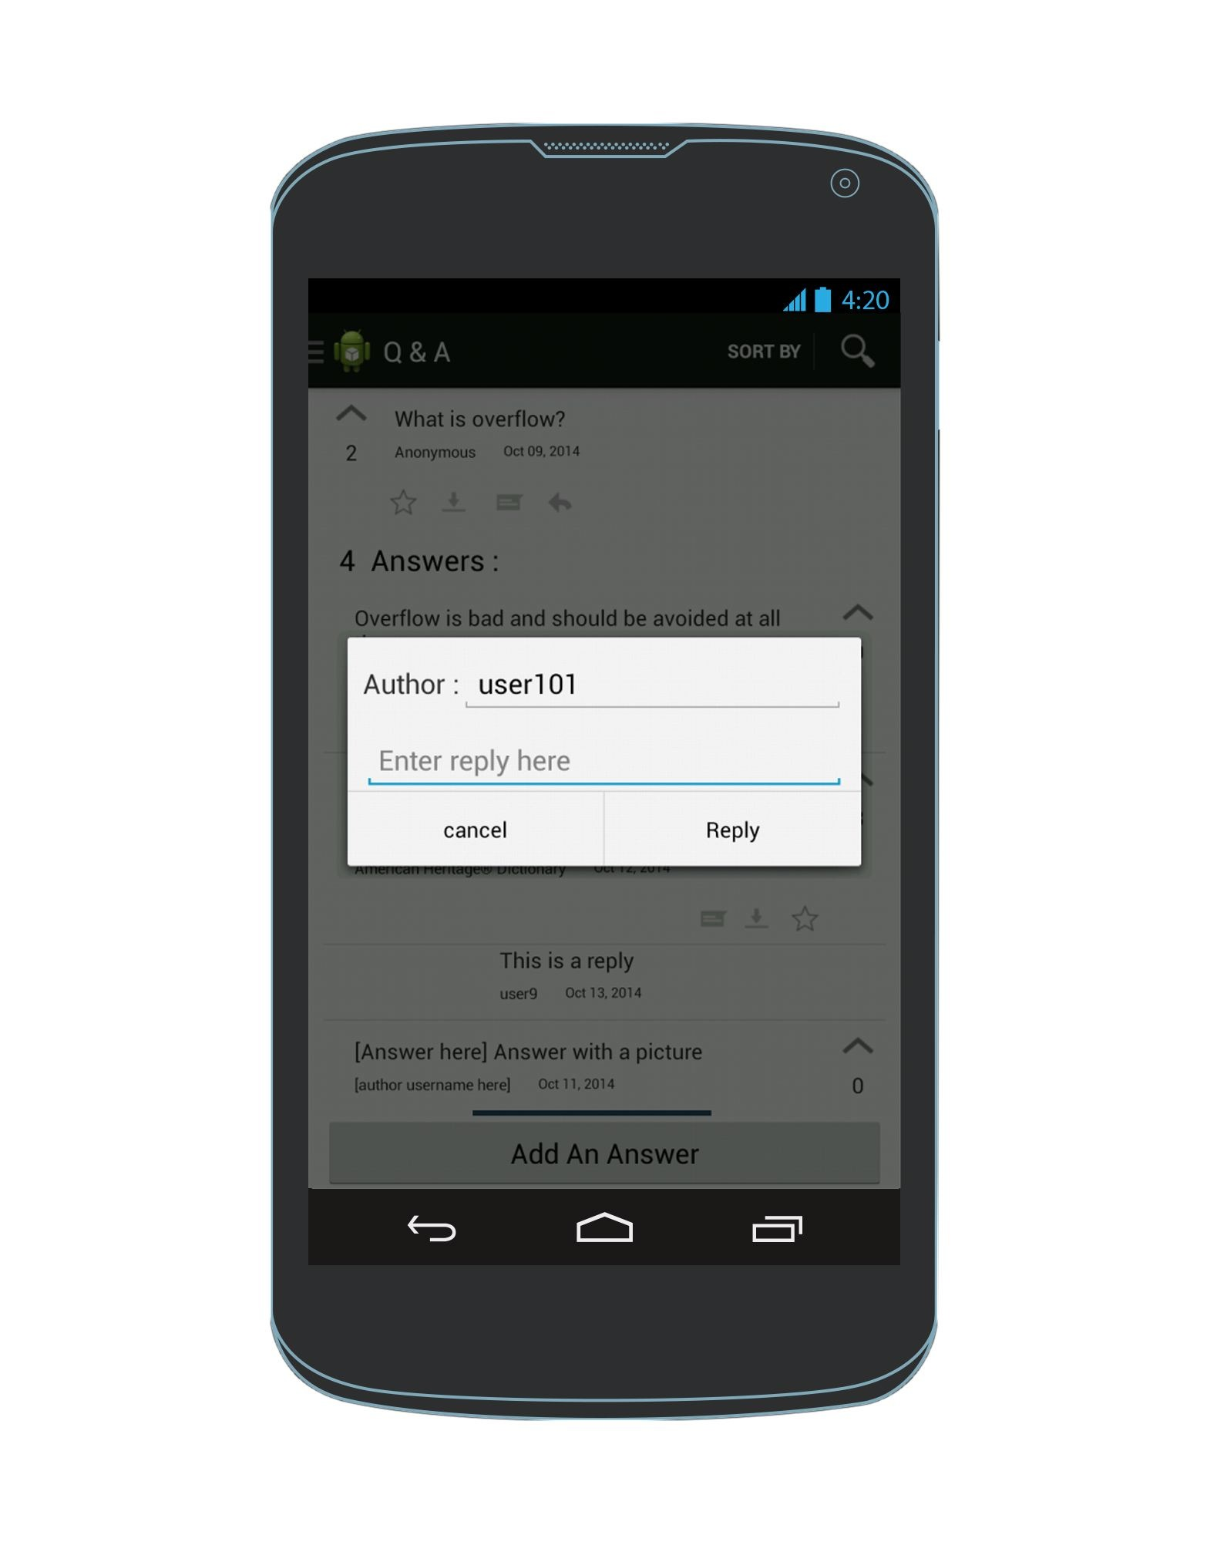
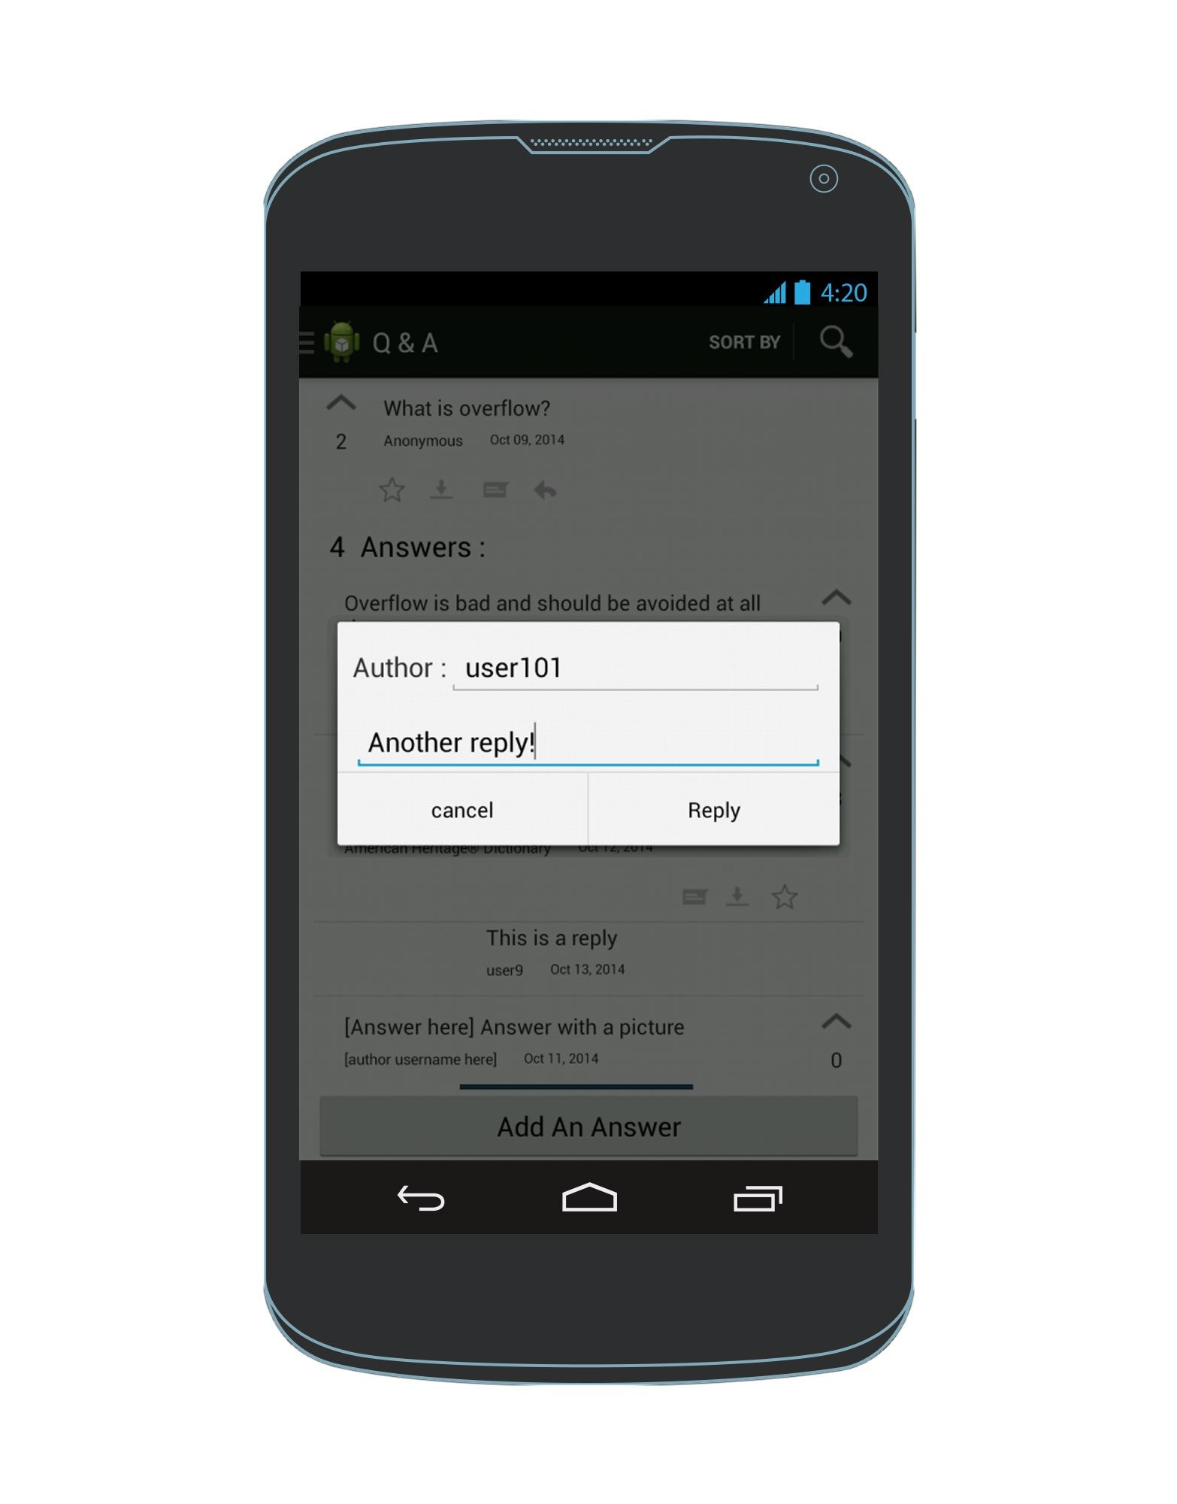
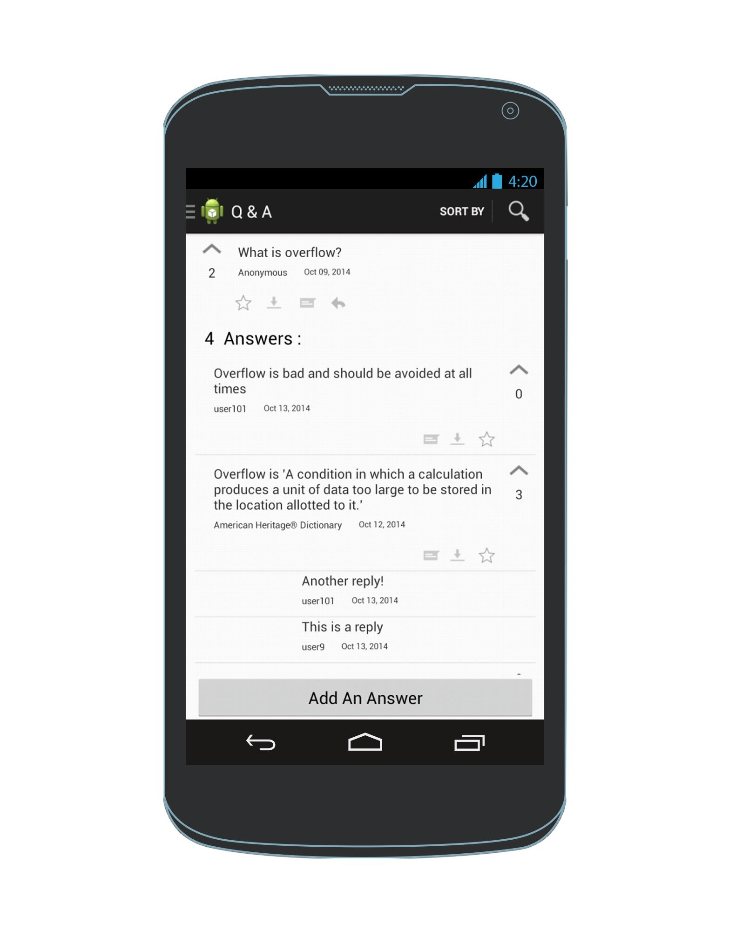
Add a reply to an answer
Enter a reply
Q & A View
AddAReply Screen
Q & A View

